Slide 1
Quantifying exposure to engineered nanomaterials from Manufactured products
QEEN II
Session 1
October 9, 2018

Slide 2

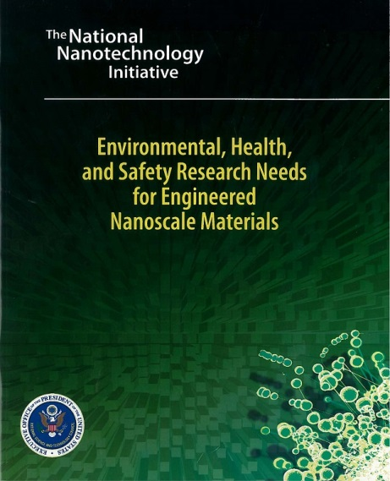
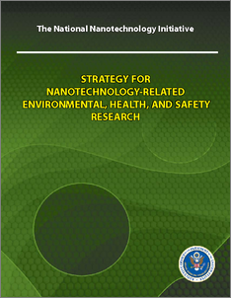
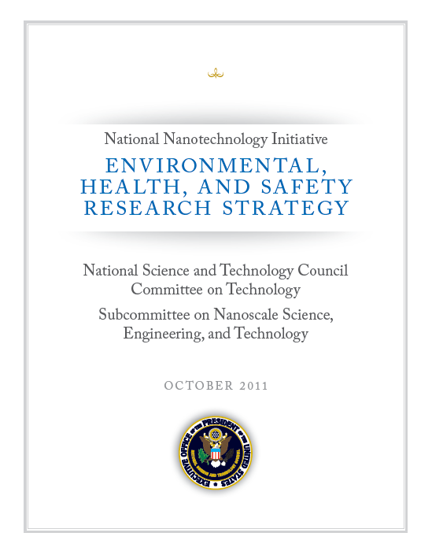
The 2011 NNI Environmental, Health, and Safety Research Strategy
Serves as a comprehensive and more detailed follow-up to a prior initial strategy (2008) and identification of research needs (2006)
Provides guidance to Federal agencies on research activities, priorities, and program planning
2006
(published 2007)
2008
2011
Notes:
The NNI EHS Strategy highlights key EHS research priorities. It guides Federal agencies’ strategic decisions for current and future research programs:
Process
Reviews of 2008 strategy
Workshops with stakeholder engagement
Assessment of strengths and weaknesses
Writing Process
Structure
Vision, mission
Research framework
Core chapters
Path forward
What’s New
Informatics and predictive modeling
Key concepts for targeting and accelerating research
Best practices for coordination and implementation of research

Slide 3
Risk-Based Framework for Addressing Nanotechnology Health and Safety Implications
2011 National Nanotechnology Initiative (NNI) Environmental, Health, and Safety (EHS) Research Strategy
  Employ science-based risk analysis and risk management
  Research Needs
    Understand processes and factors that determine exposures to nanomaterials
    Identify population groups exposure to engineered nanomaterials
    Characterize individual exposures to nanomaterials
    Conduct health surveillance of exposed populations

Slide 4
The 2011 NNI EHS Strategy: A conceptual framework that incorporates risk-assessment, risk management, and life cycle analysis to inform specific research principles
Source: EPA
Notes:
The life cycle perspective on risk assessment. Life cycle assessment supports sound product development, responsible nanomanufacturing (scaling up), and protection of public health

Slide 5
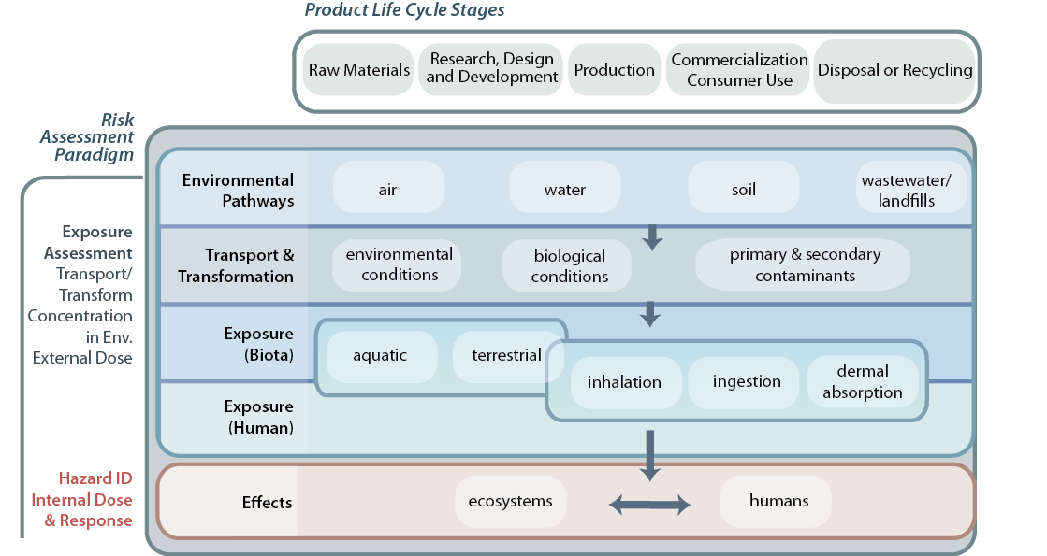
Notes:
_This figure incorporates these key risk assessment components with nanomaterial life cycle stages and the exposure-effect pathways.
_It maps Product Life Cycle Stages (top) against the risk assessment paradigm (left) to create a matrix that more clearly specified the research needed to achieve the risk management goals of the strategy.
_The point of this diagram is to highlight the complexity of questions that need to be answered, for e.g. questions of transformations.
_What fundamental questions do we need to answer to move forward?

Slide 6
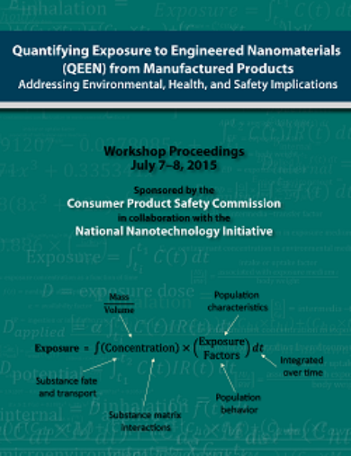
Call to Action for Exposure Science and Nanotechnology Communities
Quantifying Exposures to Engineered Nanomaterials (QEEN) Workshop
July 7-8, 2015, Rosslyn, VA
Co-sponsored by CPSC and NNI
Bring together and engage stakeholders
Focus on lifecycle exposures: from production, use and disposal
Identify methods and approaches from various media
Understand global efforts for exposure science
Re-invigorate US – EU Communities of Research (COR)
QEEN report released March 28, 2016 nano.gov

