Slide 1

Roundtable Discussion:
Connecting the Pieces
Igor Linkov, Ph.D.
Risk and Decision Science Focus Area Lead, US Army Engineer Research and Development Center, Department of Defense
Igor.Linkov@usace.army.mil

Slide 2
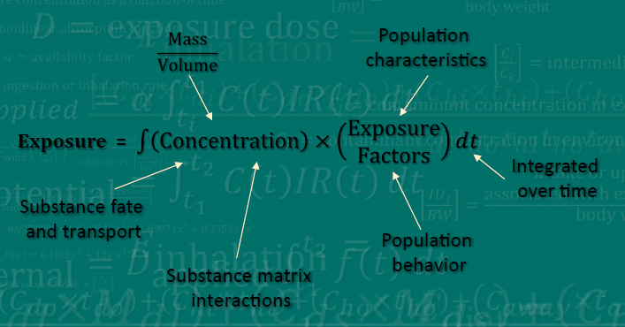
What did we Learn at QEEN 1?

Slide 3
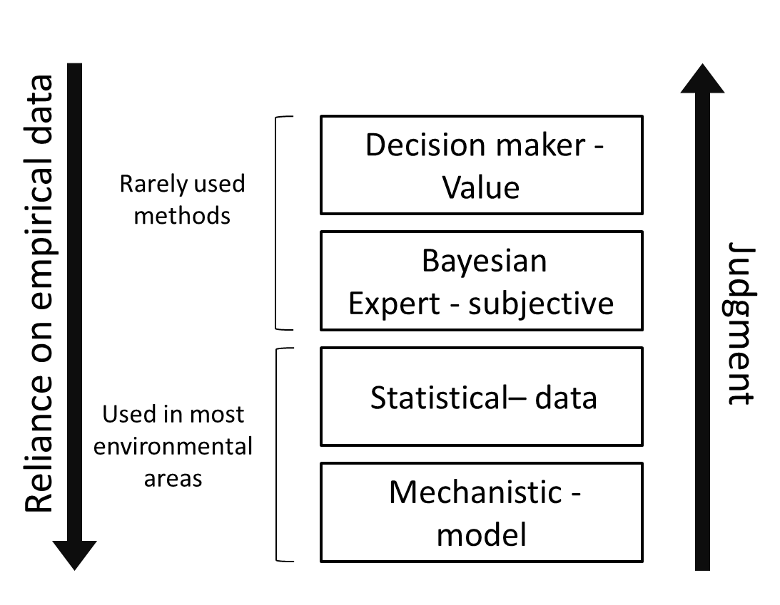
Ways to Connect the Pieces:
Bottom-Up
Risk-Based Approach

Slide 4


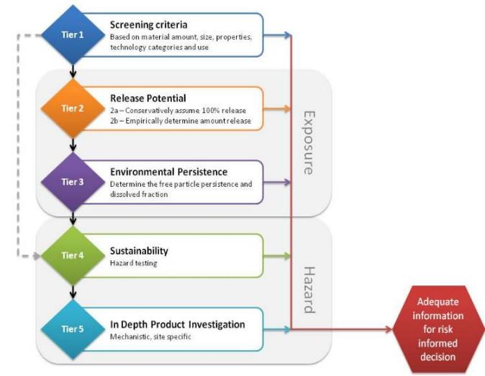
Bottom-Up Risk Based
Guide for Collection and Generation of Environment, Health, and Safety Information for Nanomaterials and Nano-enabled Products (WK48313)
Collier, Kennedy, Poda, et. al., 2015, J. Nano. Res., 17(3): 155

Slide 5
Ways to Connect the Pieces
Top-Down
Decision-Based Approach

Slide 6
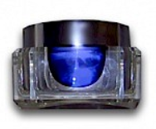
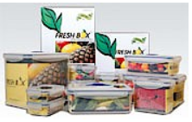

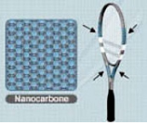
Nano Prioritization Tool
Numerous stakeholders across the globe are concerned with safety of nano-enabled consumer products (a 30-fold increase from 2005 to 2015)
Even the largest stakeholders do not have the resources to perform a formal risk assessment for every nano-enabled consumer product
Cosmetic products
(improved cleansing and absorption)
Food packaging
(reduce moisture & bacteria)
Children’s toys and blankets
(antimicrobial protection)
Polymer composite materials
(lighter and more durable)
Stakeholders need the ability to screen and prioritize a diverse array of nano-enabled consumer products in order to prioritize research into risks, triage reported safety concerns, and allocate limited resources more efficiently
Notes:
e.g., in the US, the Consumer Product Safety Commission had an FY16 budget of $125M with a staff of 567 personnel (more than 15,000 types of consumer products within its jurisdiction)
Limited resources may be stretched further

Slide 7
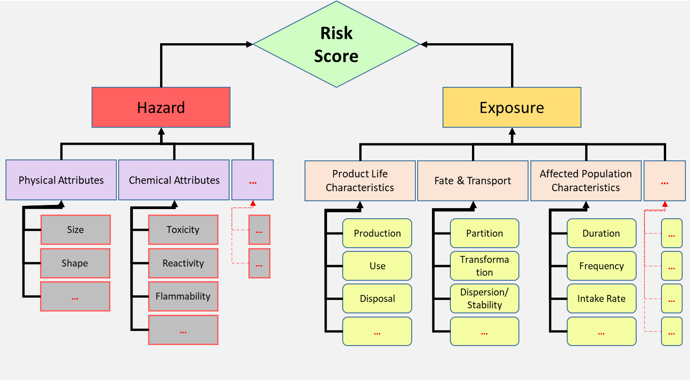
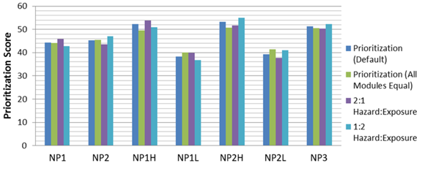
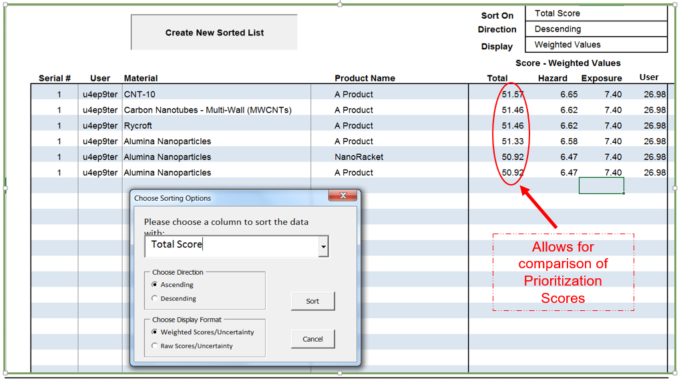
Application Example

Slide 8
Approaches to Bringing Pieces Together
Property/Process Based
Simplified process models, Less Data Intensive
Omics
Networks
AOP
Expert- or data-driven weights
Decision Analysis
Data Driven
AI
Blockchain
CompTox
Complex
Data Intensive

Slide 9
Data-Driven Integration
Top-Down
Decision Analysis/Social Science
Bottom-Up
Risk Assessment/ Physical Sci
Goal Identification and Problem Framing
-
What are the goals,
alternatives, and
constraints?
Data Collection
-
What are fundamental properties/mechanisms
associated with each alternative?
Management
Decision Model
-
What are the criteria and metrics, How do we measure decision-maker values
Modeling
Physical/Statistical Model
-
What is the hazard?
What is exposure?
Metrics Generation and Alternative Scoring
-
How does each alternative score along our identified criteria and metrics?
Data
Collection
Risk Characterization
-
What are the risks relative to a threshold? How do they compare to other alternatives?
Linkov et al., 2014

Slide 10
Panel:
  Ben Trump (Army/ORISE) – Risk and Governance, Top-Down
  Will Boyes (EPA) and Mark Wiesner (Duke)- Risk-Based, Bottom-Up
  Wu-Sheng Shih (Brewer) – Safety by Design, Integration

