Slide 1
Dosimetry models to align nanoparticle dose across systems for better risk assessment
Jordan Ned Smith
jordan.smith@pnnl.gov
Pacific Northwest National Laboratory
Richland, WA, USA

Slide 2
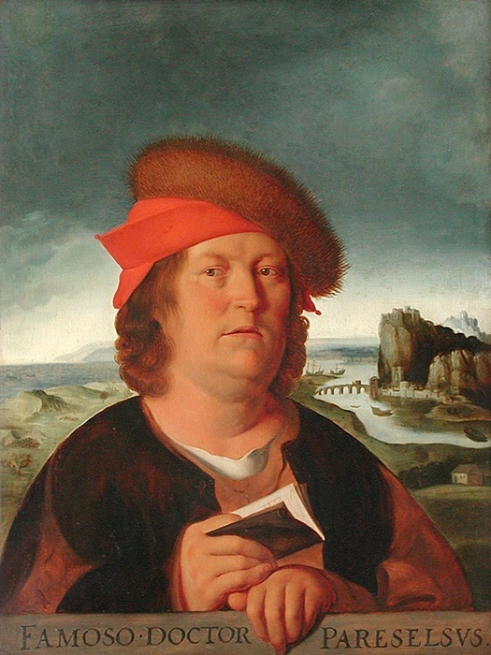
The dose makes the poison

Slide 3
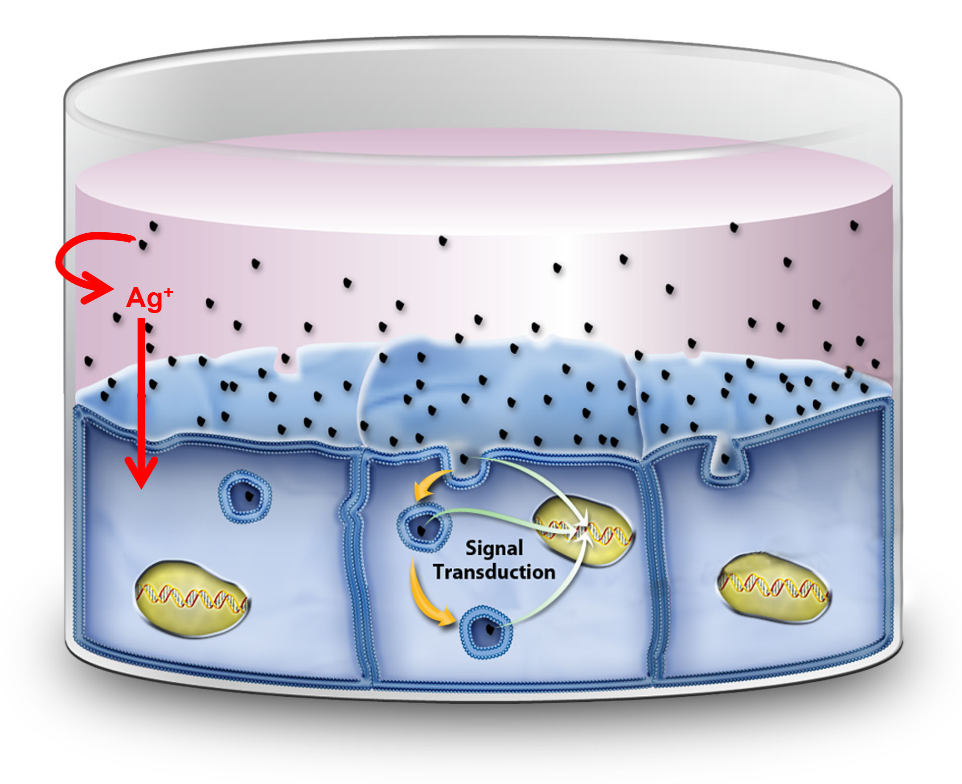
In vitro nanotoxicology

Slide 4
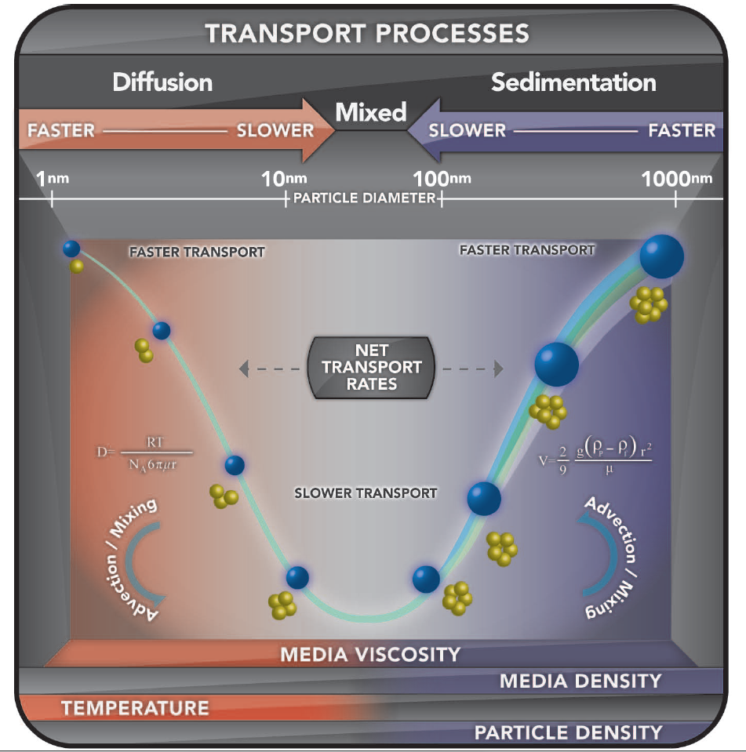
Nanoparticle transport processes
Teeguarden et al. 2007. Toxicol. Sci. 95(2): 300-312
DeLoid et al. 2014. Nat. Commun. 5, 3514

Slide 5
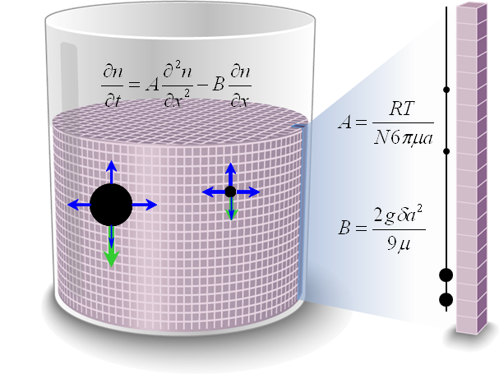
In vitro sediment diffusion and dosimetry (ISDD) model
https://nanodose.pnnl.gov/default.aspx?topic=ISDD
Hinderliter et al. 2010. Part Fibre Toxicol. 7(1) 36
Cohen et al. 2014 Part Fibre Toxicol. (11) 20

Slide 6
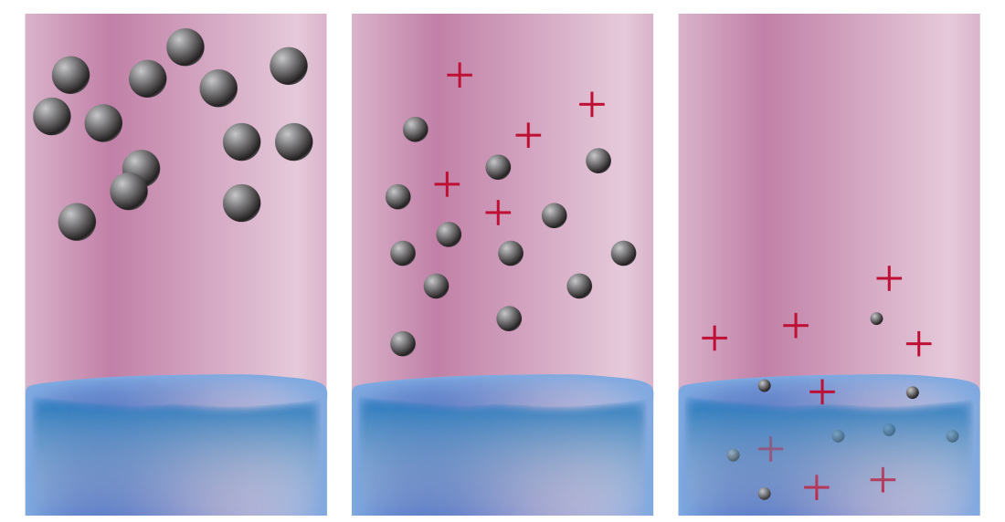
ISD3: Implications of dissolution
Time
Liquid column height
Particle sedimentation and diffusion
Particle dissolution and ion release
Particle and ion uptake by cells
https://nanodose.pnnl.gov/default.aspx?topic=ISD3
Thomas et al. 2018. Part Fibre Toxicol. 15(1) 6

Slide 7
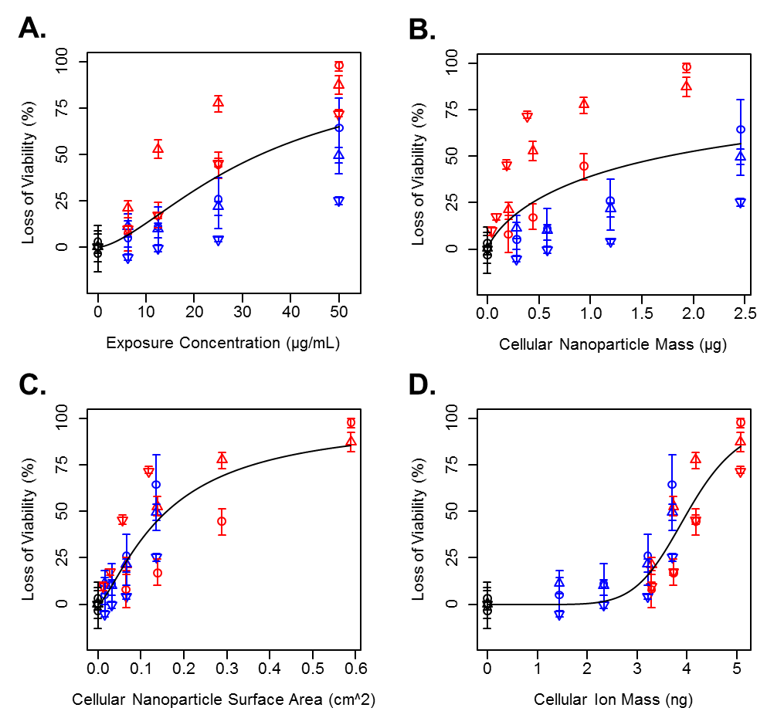
Enables dose response analysis with various dose metrics
Smith et al. 2018. Part Fibre Toxicol. In Review

Slide 8
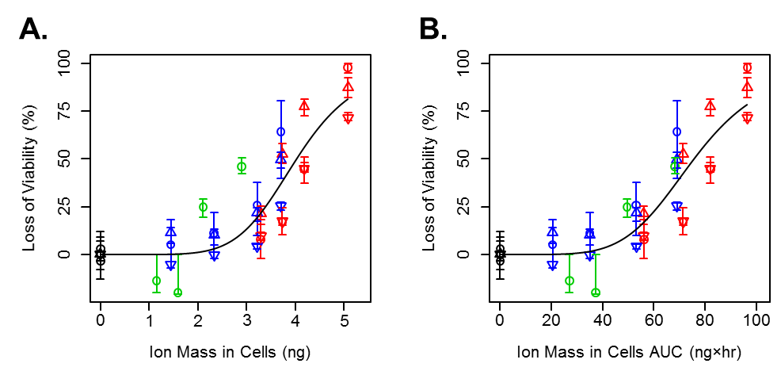
Including ion only exposures
Smith et al. 2018. Part Fibre Toxicol. In Review

Slide 9

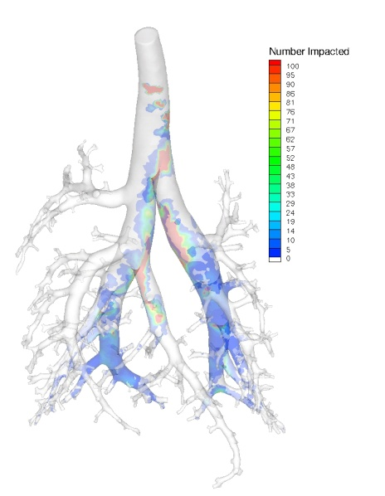
Animal models and humans
https://www.ara.com/products/multiple-path-particle-dosimetry-model-mppd-v-304
Shallow Breathing
Deep Breathing
Anjilvel et al. 1995. Fundam. Appl. Toxicol. 28, 41-50.
Asgharian et al. 2001 Aerosol Sci and Tech 34:4, 332-339.
Asgharian and Price 2007 Inhal. Toxicol. 19: 1045-1054.
Miller et al. 2016. J. Aerosol Sci. 99, 14-26.

Slide 10
Conclusions
Dose makes the poison
In order to realize Tox 21 vision, we need to understand nanoparticle dose
Dosimetry models exist to predict nano dose
  Conventional cell cultures
    MPPD version needed for air liquid interface assays?
  Animal models
  Humans
    Includes children geometries
Models can be used to design toxicity in vitro assays based on exposure assessments
Aligning dose across systems is essential for successful risk assessment

Slide 11
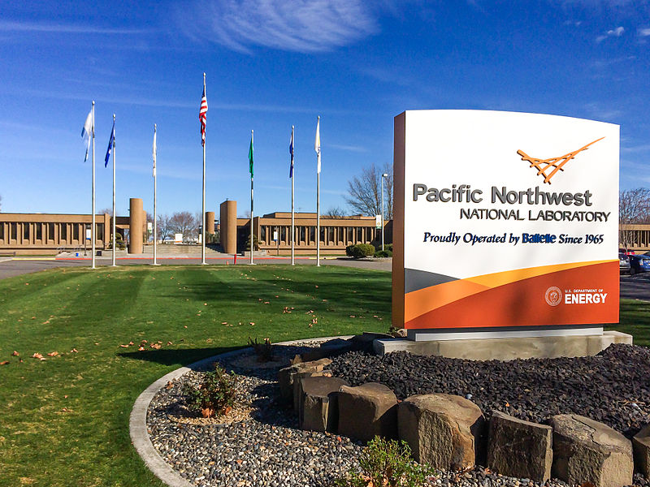
Questions?
jordan.smith@pnnl.gov

