Slide 1
The Fate of Nanoparticles in Food Packaging
Maria Rubino, PhD
Professor
School of Packaging
East Lansing, MI

Slide 2
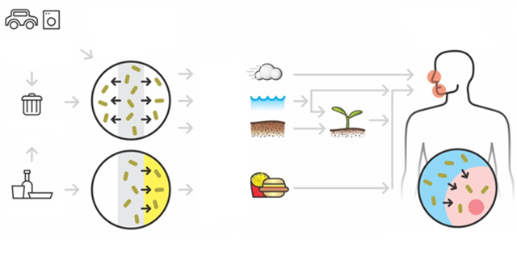
Public concerns
Routes of human exposure to nanoparticle (from nanocomposites) → interaction with biological systems
Human
exposure
to ENPs
ENP
Release from
polymers
Consumer
goods
Air
Water
Disposal
Soil
Food
Packaging
Interaction with cells
Notes:
Nanoparticles release into water or soil, interacting with microorganisms that biodegradate the polymer, will nanoparticles affect those microoganisms? If they do affect, they will compromise the biodegradation process. (point at that area, water soil..)
The wide use of nanocomposites has raised concern about the probable release of nanoparticles exposing the environment and biological systems to those nanoparticles. This image shows how engineered nanoparticles including nanoclay particles enter the biological system. One route could be via a nanocomposite packaging in contact with food, the nanoparticles are released into the food which is digested by humans.Other rountes could be via consumer goods made of nanocomposites that are maunfactured in work place or buried in landfill, the nanoclay particles are released into the surrouding enviroments such as atmoresphere, water or soil, and finally reach plants, animals or humans. Once the nanoparticles enter the biological system, they may interact with living tissues or cells, causing some undesired health effects. Go to next slide….

Slide 3
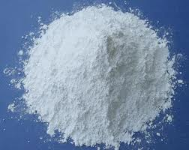
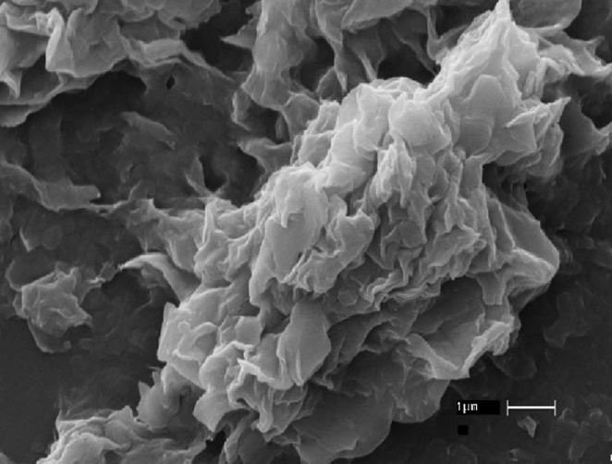
Nanoclay added in packaging
Obtained from layered silicate minerals
Common type: Montmorillonite (MMT)
MMT structure: layered structure
Images from www.google.com
Notes:
The additive I concerned in this research is nanoclay, which is obtained from natural layered silicate minerals with montmorillonite or MMT as the most common type used in industry scale. The left image shows the MMT clay powder, if we enlarge it, as shown in the middle image, we can see that MMT clay has a layered structure and the clay layers are stacking together to form a big cluster. The right image shows the crystal structure of a clay layer, which is mainly consisted of three elements: O, Si & Al. The space between the layers are called clay gallery containing some exchangeble ions. Those ions could be replaced by organic surfactants. Go to next slide…

Slide 4
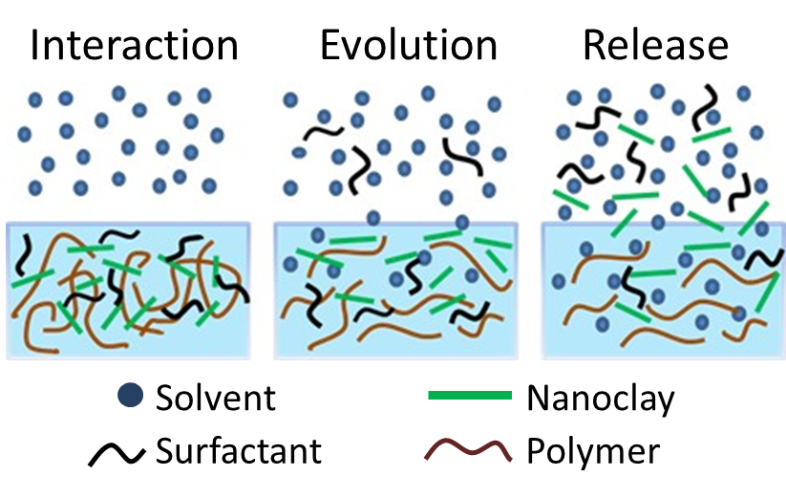
Hypothesis

Slide 5
Fluorescent labeling and tracking of nanoclay
Diaz, Xia, Rubino, Auras, Jayaraman, Hotchkiss. Nanoscale 2013. 5:164-168
Notes:
So a nanocomposite of PP and Nylon with 3% labeled nanoclay was produced
Two labels were considered in case of interference
The label withstand the processing

Slide 6
Experiment: release of nanoclay
ASTM D4754-11
Film area: 100 cm²
Simulant: ethanol
Solvent volume: 40 mL
Temperature: 22, 40, 70 ºC
Migration cell: PP or glass
Multiple sampling points
Control samples applied:
Film without nanclay (assessment on nanoclay)

Slide 7
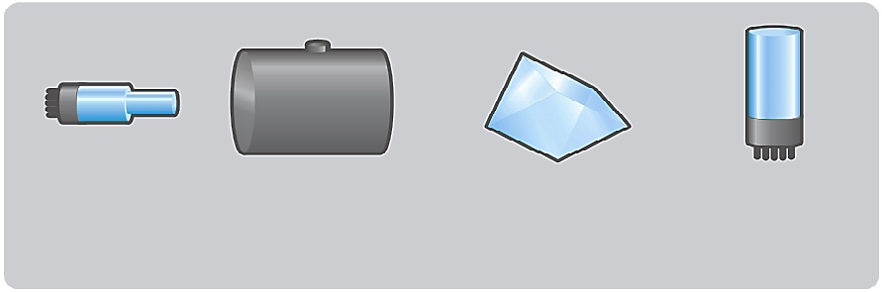
Instrumental analysis for Nanoclay
Xia Y, Rubino M, Auras R. 2013. Detection and quantification of montmorillonite nanoclay in water-ethanol solutions by graphite furnace atomic absorption spectrometry Food Addi. Cont. 30: 2177-2183.
Si & Al
Light Source
Graphite Furnace
Monochromator
Detector
Graphite Furnace Atomic Absorption Spectrometry (GFAAS)
Instrumental conditions
Stability test
Correlation
Calibration curve & quantification limit
Effect of solvent & surfactant on dispersion
Si & Al contents
in the nanoclay
Internal validated by X-Ray Fluorescence(XRF)
Limit of quantification : 0.03 mg L⁻¹ (Si) and 0.01 mg L⁻¹ (Al)

Slide 8
Release of Nanoclay at 22, 40 & 70 ºC
Xia Y, Rubino M, Auras R. 2014. Release of Nanoclay and Surfactant from Polymer−Clay Nanocomposites into a Food Simulant. Environ. Sci. Technol. 2014, 48, 13617−13624
Release from PP-clay
Release from PA6-clay
(a)
(b)
A small amount of nanoclay was released (0.1~0.2%)
More nanoclay release from PP-clay than from PA6-clay
Depending on the polymer-clay interaction

Slide 9
Experiment: release of surfactant
Xia Y., Rubino M, Auras R. 2016 Modeling of surfactant release from polymer-clay nanocomposites into ethanol Polymer Testing 60, 57-63
ASTM D4754-11
Film area: 100 cm²
Simulant: ethanol
Solvent volume: 40 mL
Temperature: 22, 40, 70 ºC
Migration cell: PP or glass
Multiple sampling points
Control samples applied:
Film without nanoclay (assessment on nanoclay)

Slide 10
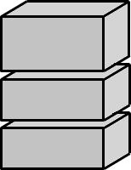

Instrumental analysis for surfactant
Xia Y, Rubino M, Auras R. 2015. Release of surfactants from organo-modiﬁed montmorillonite into solvents: Implications for polymer nanocomposites. Applied Clay Science 105-106 (2015) 107–112
HPLC
Ion source
First
mass filter
Collision
cell
Second
mass filter
Detector
Liquid Chromatography-Tandem Mass Spectrometry (LC-MS/MS)
Instrumental conditions
Sample preparation
Calibration curves
Temperature
Quantification limit
Sonication
Composition
Solvent type
Notes:
Use hyperlink for temp. sonication and solvent type. Put ion for each box..

Slide 11
Release of surfactant at 22, 40 & 70 ºC
Xia Y, Rubino M, Auras R. 2014. Release of Nanoclay and Surfactant from Polymer−Clay Nanocomposites into a Food Simulant. Environ. Sci. Technol. 2014, 48, 13617−13624

Slide 12
Further Assessment from the release study from nanocomposite:
Xia Y, Rubino M, Auras R. 2015. Release of surfactants from organo-modiﬁed montmorillonite into solvents: Implications for polymer nanocomposites. Applied Clay Science 105-106 (2015) 107–112
TEM images of released nanoclay particles from the PP−clay films and the corresponding EDS analysis for the particle in image (a). The structures (multiple parallel lines) shown within the circles exhibit a stack of clay layers. Scale bar: 50 nm for image a, 200 nm for images b and c.
Notes:
Nanoparticles release into water or soil, interacting with microorganisms that biodegradate the polymer, will nanoparticles affect those microoganisms? If they do affect, they will compromise the biodegradation process. (point at that area, water soil..)
The wide use of nanocomposites has raised concern about the probable release of nanoparticles exposing the environment and biological systems to those nanoparticles. This image shows how engineered nanoparticles including nanoclay particles enter the biological system. One route could be via a nanocomposite packaging in contact with food, the nanoparticles are released into the food which is digested by humans.Other rountes could be via consumer goods made of nanocomposites that are maunfactured in work place or buried in landfill, the nanoclay particles are released into the surrouding enviroments such as atmoresphere, water or soil, and finally reach plants, animals or humans. Once the nanoparticles enter the biological system, they may interact with living tissues or cells, causing some undesired health effects. Go to next slide….

Slide 13
Final comments:
1 Assessment of nanoparticles release requires:
  Development and validation of new methodologies for assessing nanoparticles release from nanocomposite
  New ways to judge the results
  2. It is very important to elucidate what is the best approach to measure nanoparticles interaction with polymers and how such interaction impact the release under different conditions before evaluating exposure and safety.
Notes:
Nanoparticles release into water or soil, interacting with microorganisms that biodegradate the polymer, will nanoparticles affect those microoganisms? If they do affect, they will compromise the biodegradation process. (point at that area, water soil..)
The wide use of nanocomposites has raised concern about the probable release of nanoparticles exposing the environment and biological systems to those nanoparticles. This image shows how engineered nanoparticles including nanoclay particles enter the biological system. One route could be via a nanocomposite packaging in contact with food, the nanoparticles are released into the food which is digested by humans.Other rountes could be via consumer goods made of nanocomposites that are maunfactured in work place or buried in landfill, the nanoclay particles are released into the surrouding enviroments such as atmoresphere, water or soil, and finally reach plants, animals or humans. Once the nanoparticles enter the biological system, they may interact with living tissues or cells, causing some undesired health effects. Go to next slide….

Slide 14

Team

Slide 15


Acknowledgements

