Slide 1

Potential Exposure to Bactericides/Fungicides Designed with Nanomaterials in Vegetable Production for Fresh Consumption in the U.S.
Mathews L. Paret
Associate Professor of Plant Pathology
University of Florida

Slide 2
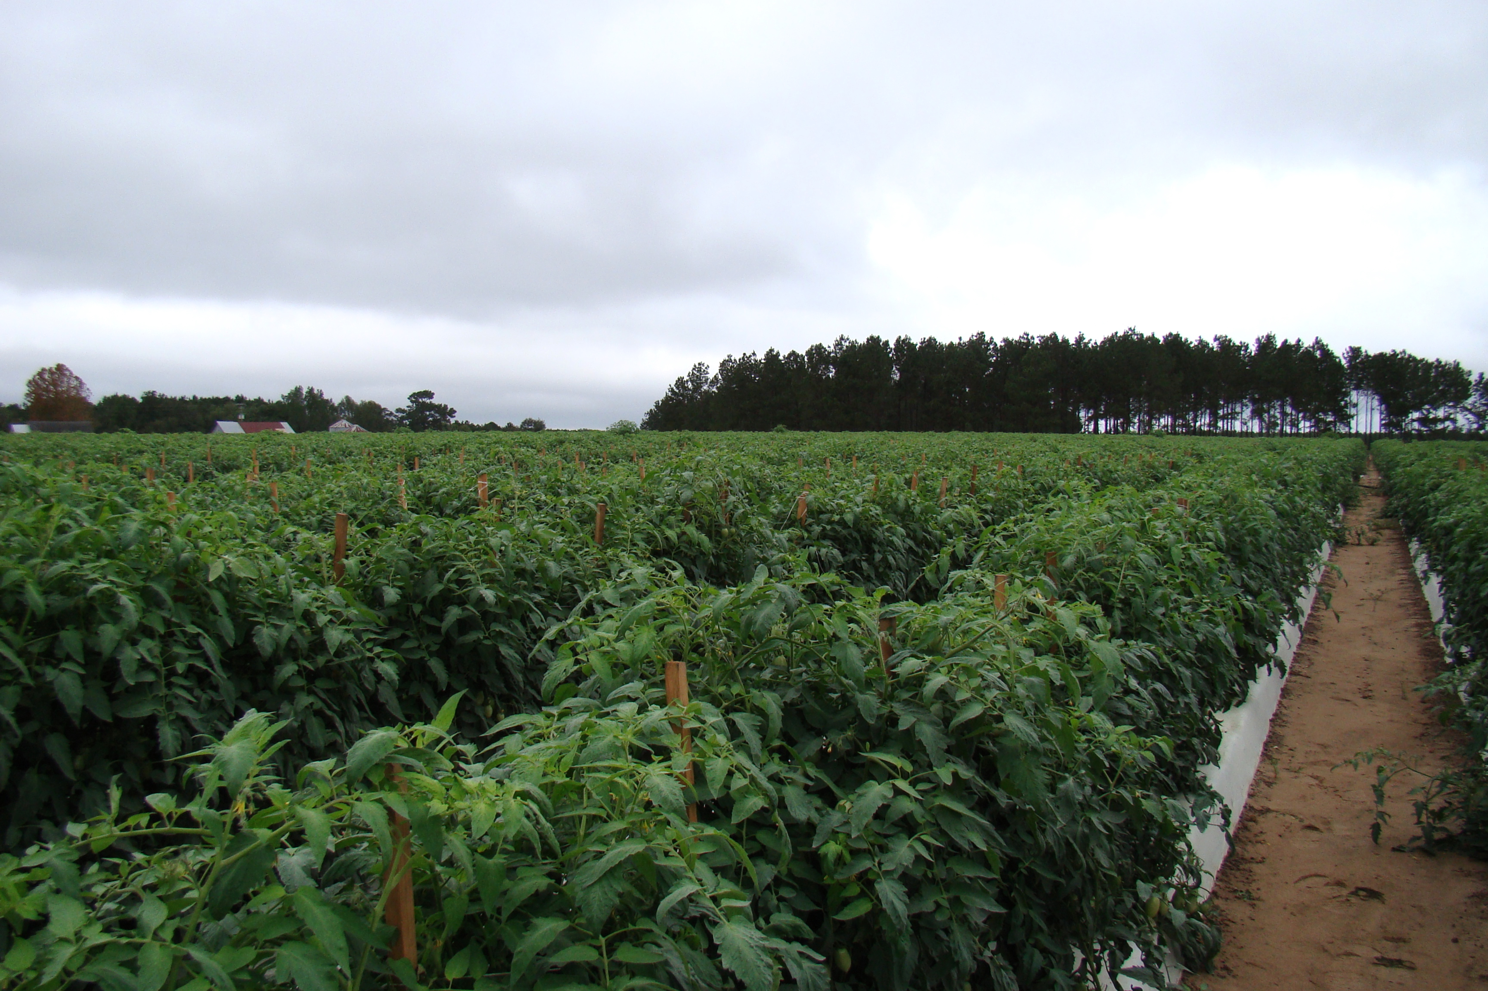
The U.S Fresh Market Tomato Industry (2017): >92,000 acres harvested; >$1.2 billion in value
Florida: 33,000 acres
California: 28,600 acres

Slide 3
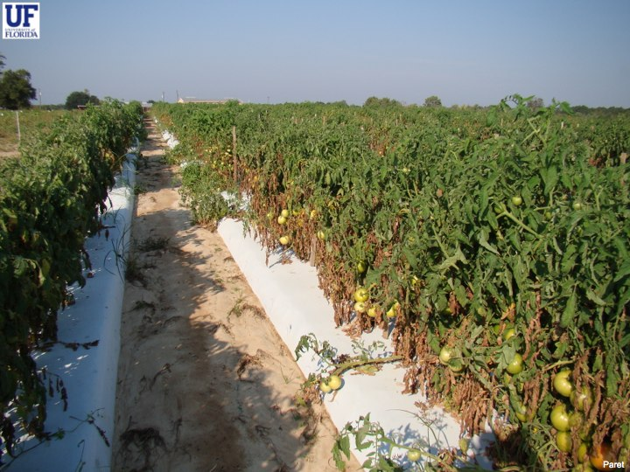
Bacterial Spot of Tomato - Topmost among bacterial diseases of tomato in the U.S and worldwide
First discovered in South Africa in 1914
Caused by 4 distinct species of Xanthomonas (X. euvesicatoria, X. gardneri, X. perforans, and X. vesicatoria). X. perforans is the dominant species in Florida
The disease can cause 20-50% yield losses under ideal conditions for bacterial spread

Slide 4
How does a typical disease management program for bacterial spot (only!) by foliar application on tomato in Florida looks like?
Antibiotics
Copper + Mancozeb
SAR Inducers (e.g. Actigard, Leap, Vacciplant)
Bacteriophages and other bio-control agents
1-2 times: Used during 1950s; continuous field use led to bacterial resistance development. Currently only used in transplant production.
10-20 times: As of 2006, all X. perforans strains (375+) in Florida are copper-tolerant.
6-10 times. Risks of yield reduction with Actigard
5-10 times: Tank mix or rotation partner as a protectant with all above materials. Effectiveness is inconsistent and environment dependent.

Slide 5
Alternative materials that killed copper tolerant X. perforans strains
TiO₂/Zn and TiO₂/Ag – Photocatalytic nanomaterials killed cells at 500 ppm, but caused phytotoxicity on plants (Partner: Ecoactive Surfaces)
Ag-ds-DNA-GO nano – Ag nanomaterials killed cells at 13 ppm (Partner: Dr. Weihong Tan)
Copper composites (copper-core shell silica, copper-multivalent, copper-fixed quat) (Partner: Dr. Swadeshmukul Santra)
Metal oxides (MgO & others) - MgO killed cells at 75 ppm - U.S Nano
Cu/Zn hybrid - Killed cells at 100 ppm - U.S Nano
In comparison: Conventional copper (Kocide 3000) did not kill cells even at 500-1000 ppm

Slide 6
Lets do a simple math on Cu
In Florida copper is used as on tomatoes up to 10-20 times in a single season. ~36% of the total Cu sprayed can be found in runoff from plants which contributes to a very high accumulation level of Cu in soil that is detrimental to soil microorganisms, and aquatic organisms (Merrington et al., 2002; Rice et al., 2003).
Kocide 3000 - 27 lb/A (Maximum season rate which corresponds to ~10 lb/A of elemental copper/season (2; 20 lb/A) which comes to ~600,000 lbs of Cu annually (30,000 + acres of tomato).
What does this mean for elemental accumulation in tomatoes (fruits)?
MgO was used as a model material for evaluation
Collaborator: Dr. Jason White

Slide 7
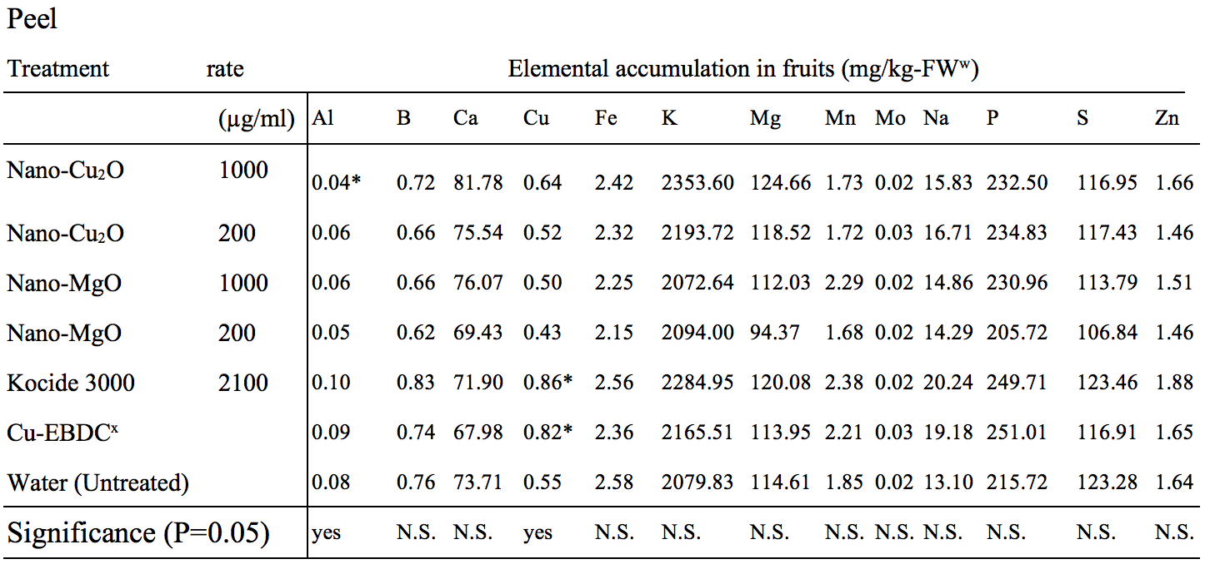
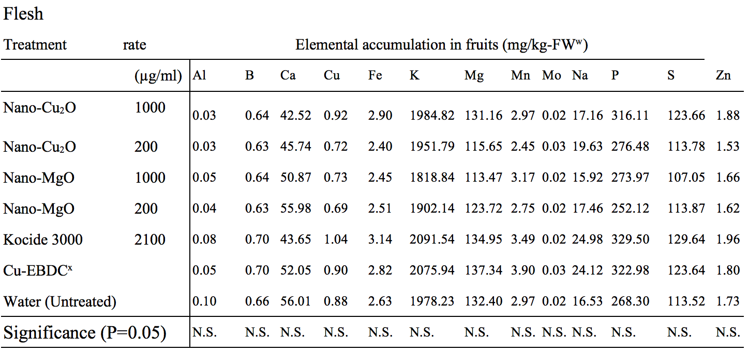
Peel
Flesh

Slide 8
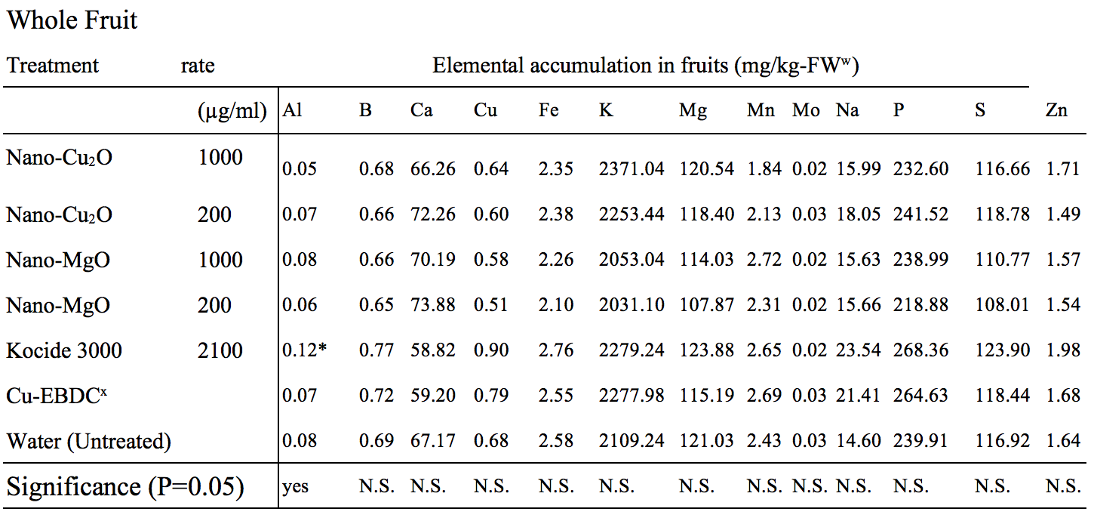
Whole fruit

Slide 9
Structural framework from a plant pathologist perspective
IDENTIFY A CLEAR ISSUE, ON WHY NANOTECHNOLOGY?
Copper-tolerance
Copper load
Fungicide resistance
Nanomaterial design
Efficacy
Fruit, leaf, soil accumulation
Impact on non-targets (microbiomes)
Trophic transfer
Occupational safety
Compatibility with other materials, cost-benefit ratio
Kocide 3000 – 27 lb/A (Maximum season rate which corresponds to ~10 lb/A of elemental copper/season (2; 20 lb/A) which comes to ~600,000 lbs of Cu annually (30,000 + acres of tomato).
Hypothetical: With copper-composites effectiveness at 1/5th the concentration to commercial Cu, we can potentially reduce Cu levels in FL tomatoes from ~600,000 lbs to ~240,000 lb with better bactericidal properties if 50% adoption of a product. Similarly MgO can significantly reduce copper load in the environment.
paret@ufl.edu

