Slide 1
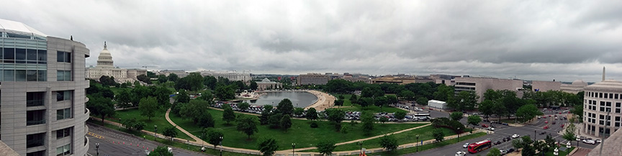
QEEN II
Breakout Session 1A: 10:30-12:00
Quantifying Potential Acute and Chronic Exposure from 3D Printing/Additive Manufacturing

Slide 2
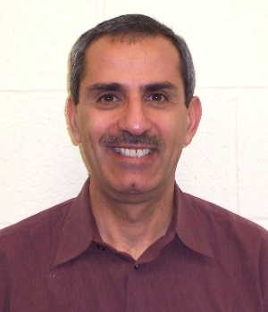

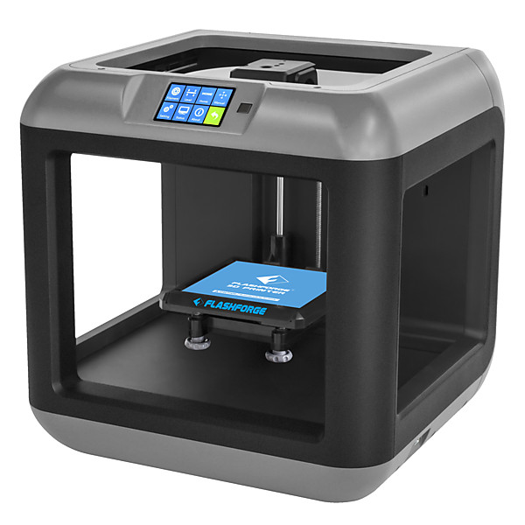
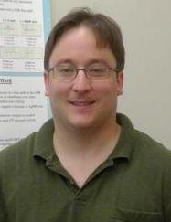

3D Printing Emissions & Nano-Enabled Products
What are the emissions?
What are effective exposure assessment strategies?
Dr. Peter Byrley
U.S. EPA
Dr. Souhail Al-Abed
U.S. EPA
What factors influence emissions from 3D printing equipment?
What are the associated health outcomes?
Dr. Justin Gorham
NIST
Dr. Sandra Pirela
Harvard

