Slide 1
Important factors in characterizing particle release during 3D printing of MWCNT enabled filaments
Justin M Gorham
Keana C. K. Scott, Sam Norris
National Institute of Standards and Technology
Gaithersburg, MD
QEEN II, October 9-10, 2018

Slide 2
Acknowledgments
James Filliben, NIST
Mitchell Slone, NIST
NIST Disclaimer
Certain commercial equipment, instruments, or materials are identified in this talk to foster understanding. Such identification does not imply recommendation or endorsement by NIST, nor does it imply that the materials or equipment identified are necessarily the best available for the purpose.
CPSC Disclaimer
This project was funded by the U.S. Consumer Product Safety Commission (CPSC). The content of this publication has not been reviewed or approved by and does not necessarily reflect the views of the Commission, nor does mention of trade names, commercial products, or organizations imply endorsement by the Commission

Slide 3
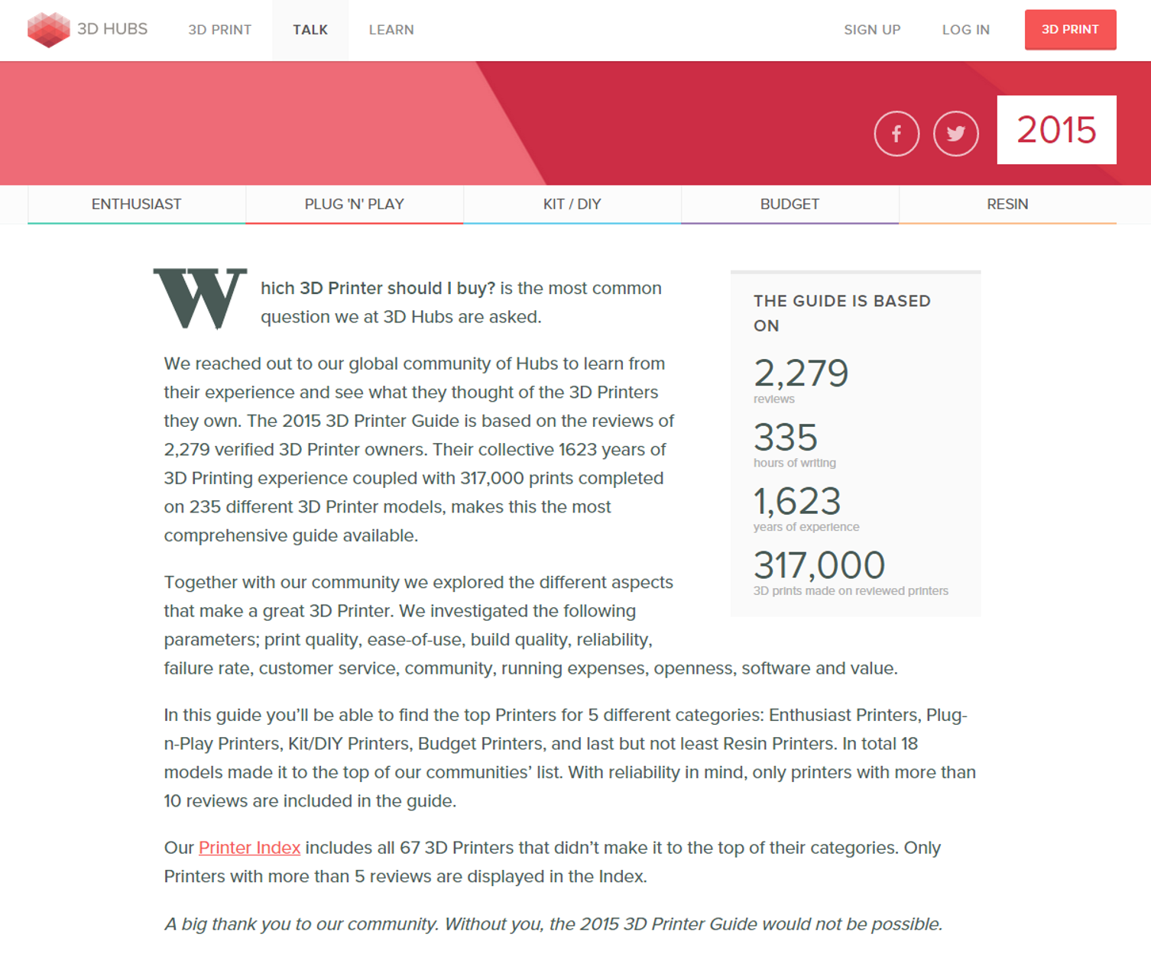
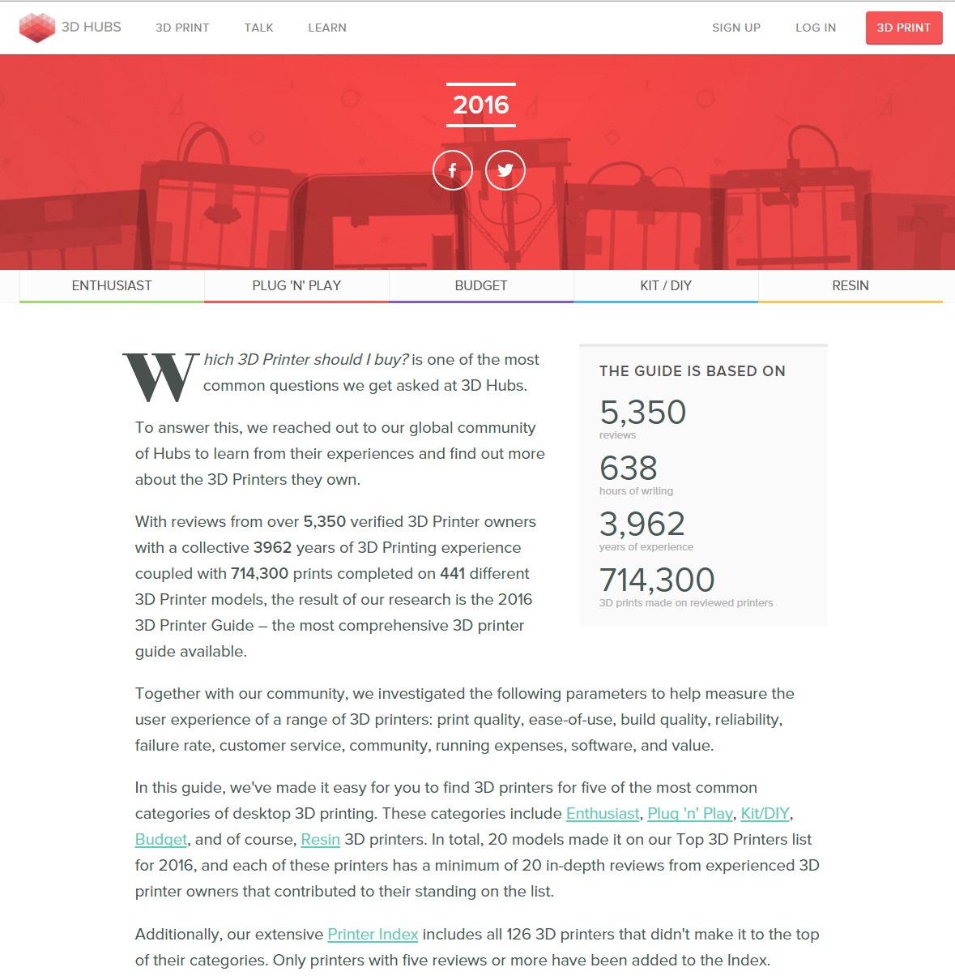
Reason for interest in release during 3D printing
Global 3D printing market has grown from estimated $3.07B in 2013 to $7.34B in 2017 while consumer 3D printing, a sub-segment of the global 3D printing market, is expected to grow from $75M in 2013 to >$500M in revenue by 2017.
2007 – 1st 3D printing system under $10,000
2012 – few consumer level 3D printers
2015 – 400+ consumer level 3D printers
2016-2017 – Est. 528,952 desktop 3D printers sold
235 different 3D Printer models
(accessed September 28, 2015)
441 different 3D Printer models
(accessed December 9, 2015)
Notes:
References
Original Source Roundup Of 3D Printing Market Forecasts And Estimates, 2014 (Forbes) Louis Columbus
- 75 M value which was the Canalys report table
Justin Gorham updated with values from https://wohlersassociates.com/press65.html
- 3.07 B value in 2013
and
Wohlers Report 2018: 3D Printer Industry Tops $7 Billion (Forbes) TJ McCue 6/4/2018
7.3 B value
>500M value
2016-2017 – Est. 528,952 desktop 3D printers sold in roughly 2 years

Slide 4
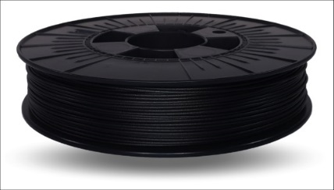
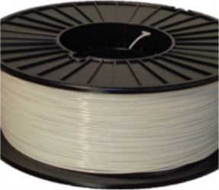
3D printing using composite filaments
VS
MWCNT loaded ABS
ABS only
In ABS, MWCNTs are employed largely to impart their electrical properties
In-house testing revealed ≈5 % by mass MWCNT loading
Prints under comparable conditions to pristine ABS feedstock
Notes:
First bullet source: www.3Dprint.com 3DXTechs Carbon Nanotube 3D Printer Filament is Here: Exclusive images and details Brian Krassenstein 5/13/2014

Slide 5
Research questions
Are particles being released from 3D printing with MWCNT-ABS filaments?
  Are released particles of a respirable size fraction?
Can we detect MWCNT release during 3D printing with MWCNT-ABS filaments?
  If so, how are they released? (bound in polymer vs. free)
  What are the important factors related to particle release?
    Distance from extruder
    Filament storage
    Extruder temperature

Slide 6
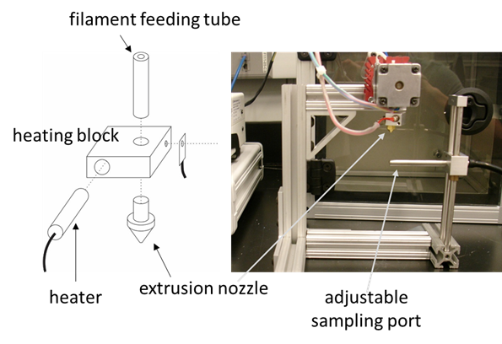
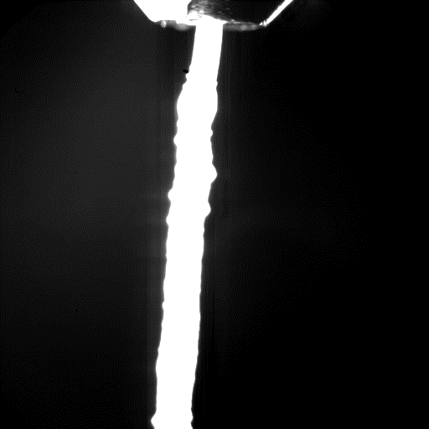
Model system
Aerosol measurement from 3D printing process
  Filaments with and without MWCNTs
  Model system to examine aerosol generation as a function of temperature and intake parameters such as a nozzle location, velocity, size, etc.
  Analyze released material with SEM
nozzle
aerosol intake nozzle
stage
PVA aerosol generation at 250 °C
Matt Staymates
Notes:
Nanometer aerosol sampler employed to collect particles and deposit on a Si wafer.
Based on one article I read, MWCNT are mostly explored in this case for their electrical properties.

Slide 7
Observations from the model system

Slide 8
Fractional factorial experimental design
Factor | Level | Value
X1: Printer Model | 1 | Model 1
 | 2 | Model 2
X2: MWCNT Concentration | 1 | Neat
 | 2 | MWCNT containing
X3: Sampling Distance | 1 | Near
 | 2 | Far
X4: Printing Temperature | 1 | Low
 | 2 | High
X5: Filament Storage Humidity | 1 | Dry box
 | 2 | Lab humidity
Two-part SEM analysis
  Evaluation of respirable fraction using low resolution automated protocol
  Evaluation of free-MWCNT release by limited sampling

Slide 9
Important experimental considerations
Choice of printed object:
  Should take sufficient time to print
  Should not cause too much movement to impact sampling air flow
Sampling nozzle placement
  Mounted on printing nozzle to reduce distance variation
Institute between run cleaning procedure and allow sufficient time for the testing chamber condition to settle
Focus on detecting particles in the respirable size range

Slide 10
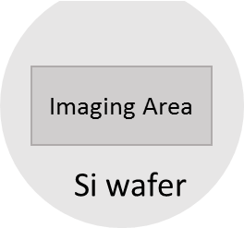
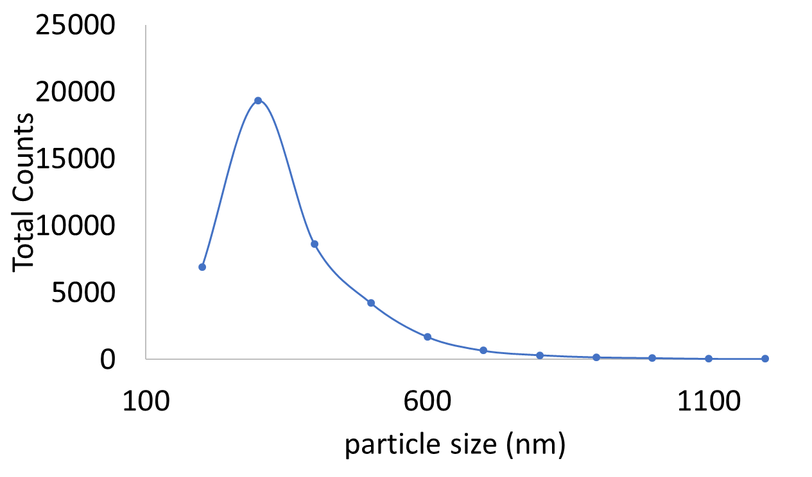
Evaluation of respirable fraction
SEM analysis of a 50 image x 50 image (12 mm x 18 mm) area
Particles were counted and evaluated for size (equivalent spherical diameter)
Size distributions and counts were compared based on different factors.
Notes:
(B) And (c) TAZ5, MWCNT, Near, 240C, Env(Run 26)

Slide 11
Summary from 3D printing study
Proximity to the extruder has the greatest effect on the total particle counts.
Neat ABS filament produced more particles of respirable size than MWCNT ABS filament during 3D printing.
Sampled particles using MWCNT ABS filament printing contained MWCNTs.
High resolution imaging necessary to detect individual MWCNTs was prohibitively resource intensive.
Additional replicates necessary for better statistics
Quantitative analysis of MWCNT release requires understanding of total material release, total sampling volume, and sampling efficiency.
We do not have the sampling efficiency number (Focus of future studies)

