Slide 1
Occupational Exposure Science
What Have We Learned Since QEEN I ?
QEEN II
QEEN II: 2nd Quantifying Exposure to Engineered Nanomaterials from Manufactured Products Workshop
October 9, 2018
Charles L. Geraci, Ph.D., CIH
Associate Director for Emerging Technologies
National Institute for Occupational Safety and Health
The findings and conclusions in this presentation have not been formally disseminated by the National Institute for Occupational Safety and Health and should not be construed to represent any agency determination or policy

Slide 2
State of the Science in 2015?
“This literature review (2000-2015) provides evidence that for ENMs, as found for other materials, the likelihood of the exposure depends largely on the physical form of the substance as well as the applied process and operational conditions. These results can be used to provide first indications of the likelihood of exposure and guidance for exposure controls in workplaces. However, there is a clear lack of high-quality exposure data, in particular for downstream use and end-of-life scenarios and in low- and medium-income countries.”
Basinas et al. Anals of Work Exposure and Health. 2018

Slide 3
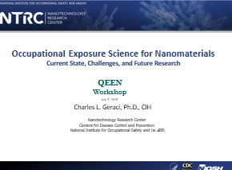
At QEEN I in 2015 we said the state of ENM exposure science was:
Complex
Focused on ‘pristine’ materials
Lacked realism
Needed consistency
Needed more life cycle
Mass still a primary metric
Exploring other metrics needed
Confirmatory analyses needed
Challenging to define ‘nano…”

Slide 4
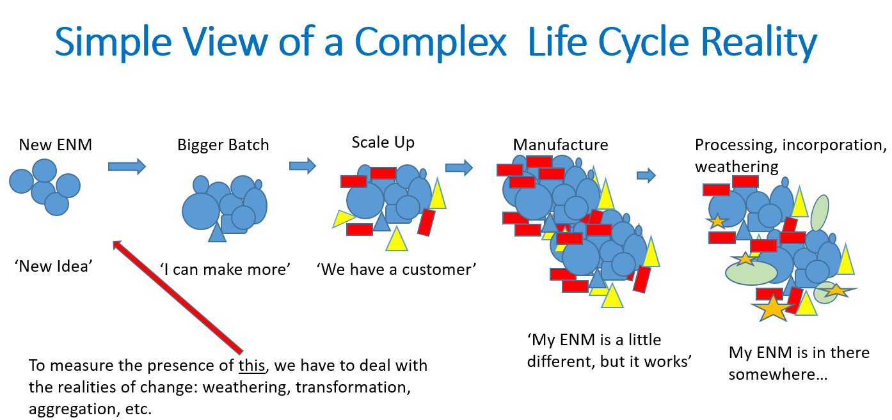
Remember this from 2015?

Slide 5
Basic Questions and Research Challenges
Detection
Measurement
Relevant measurement
Consistency
Reproducibility
Real-world encounters (Value Chain)
Good information on all of these topics will be shared in our breakout sessions.

Slide 6
Progress
Consistency in approach - examples
  OECD Tiered Approach
  NIOSH NEAT 2.0
  OECD Strategy
  ISO TC 229 Technical Guidance
Improved sampling and analytical techniques
Advanced or improved field instruments

Slide 7
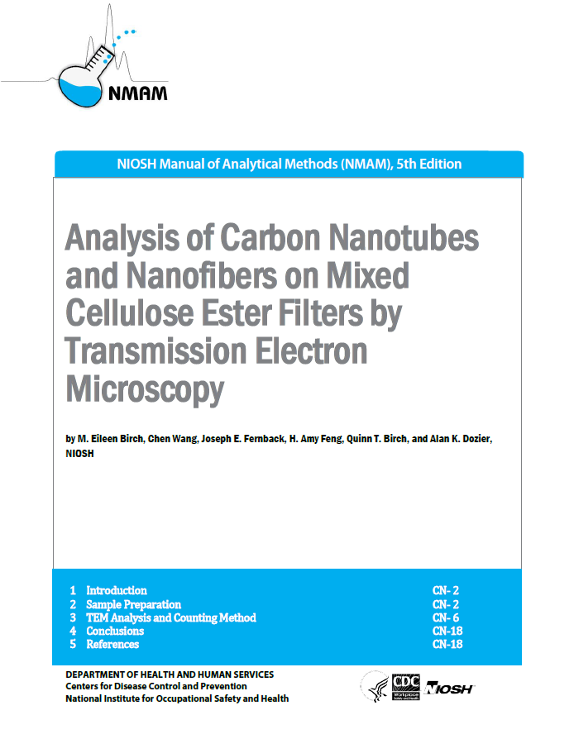
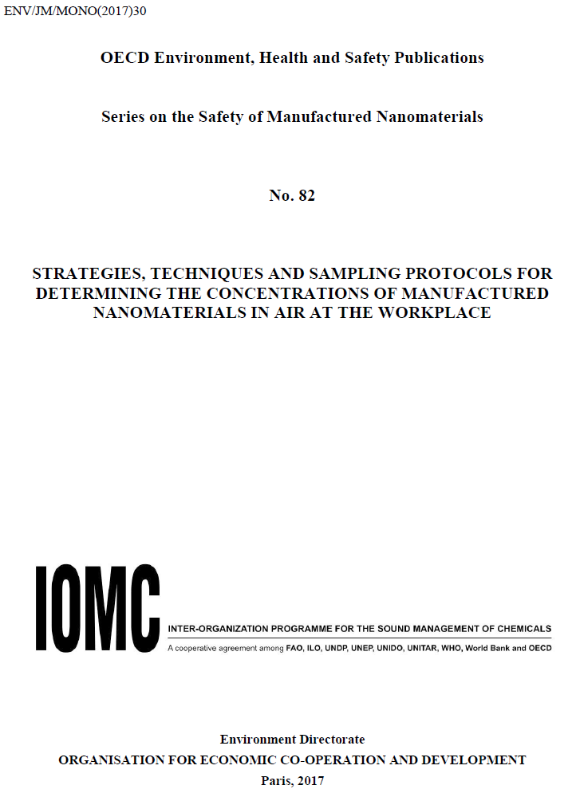
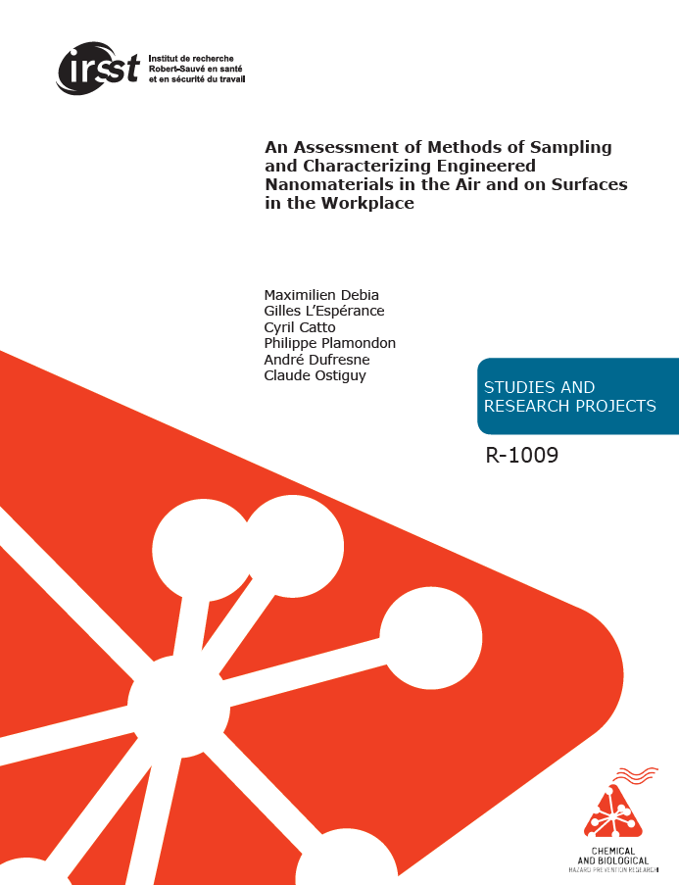
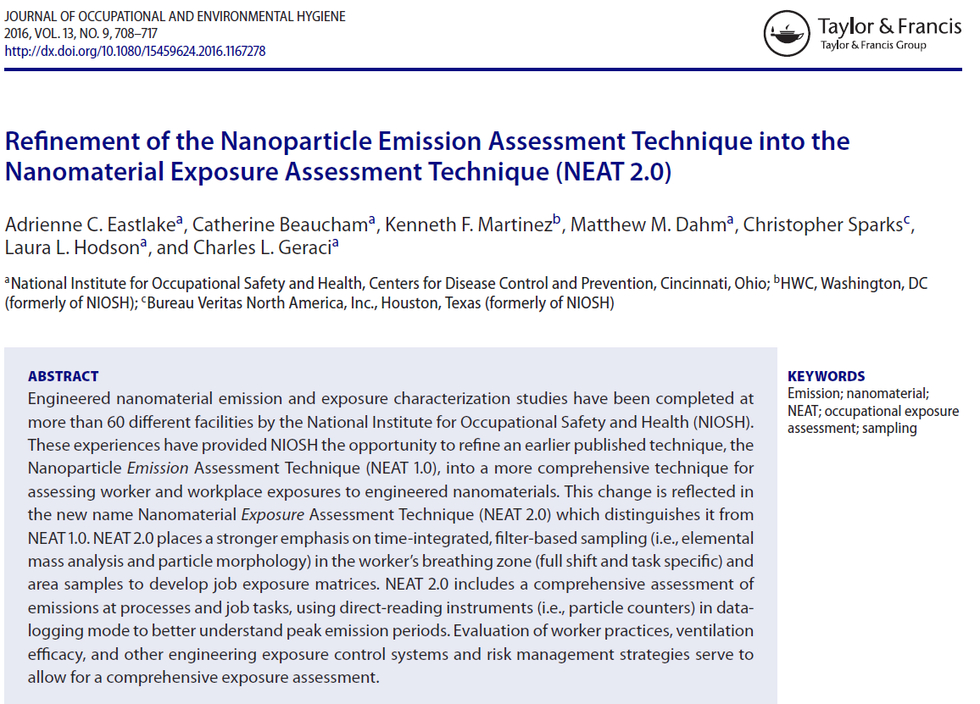
Recommended Reading
All show a similar, tiered approach
DRI
Microscopy
Elemental analysis
  Direct analysis for metals
  ‘Indicator’ analysis for CNT/CNF
Guidance for CNT ‘counting’
Updating the initial approach

Slide 8
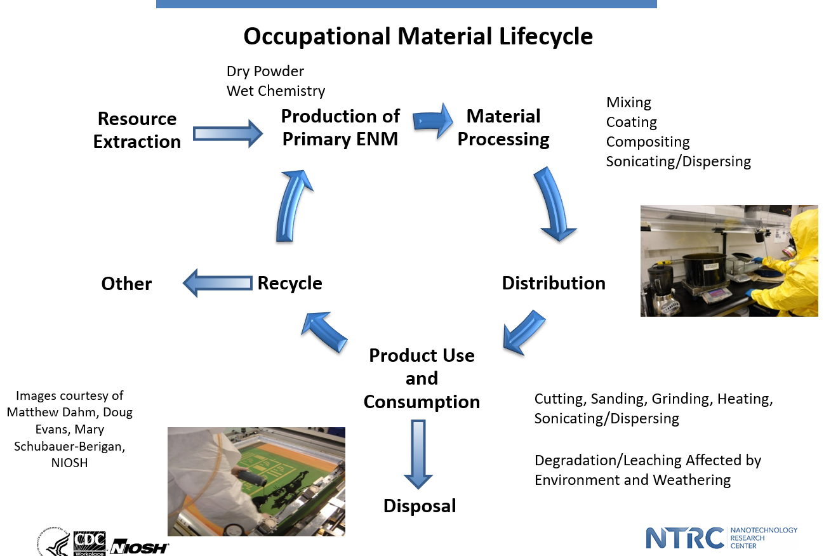
A Life-Cycle Approach
(Go to Session 1C)

Slide 9

Ultra-Fine Particulate
An opportunity to go….
Ambient air particulate matter (PM), including ultrafine (Nano sized) particulate matter (UFP) provided a foundation to study Engineered Nanomaterials (ENM). Extensive ENM knowledge can now be applied to better inform PM and UFP health risk research and vice versa.
Paraphrased from Stone et al. Environmental Health Perspectives. 2017

Slide 10
New Knowledge?
More ENMs are making it into commerce
Lines between Nano and Advanced Materials are blurred
Measurement and characterization methods are improving
Life cycle/value chain approach
Introduction into Advanced Manufacturing
Renewed focus on Ultrafine Particulate (in addition to Engineered Nano Particulate)

Slide 11
Take Home Message?
Progress is being made on several fronts to detect and measure ENM.
We accept that ENMs are one of many components in a complex industrial environment
Basic measurements can identify opportunities for exposure mitigation
Control procedures work
Joining our experience with UFP and ENM will be important

