Slide 1

The Relationship Between Nanoparticle Characterization and Risk
QEEN II: 2​nd​ Quantifying Exposure to Engineered Nanomaterials from Manufactured Products Workshop
Justin G. Clar
October 10th 2018
Elon University
Notes:
Approaching this Topic from a Different Perspective. Not going to focus on one method – but discusses a bit more on where I think we need to be focuses our efforts on characterization of NP and Nanomaterials

Slide 2
Risk Assessment Process (greatly simplified)
Hazard Identification
What is the chemical?
Negative Effects?
Exposure Assessment
Concentration?
Speciation?
Dose Response
Acute
Chronic
Thresholds?
Risk Characterization
Estimate Exposed Population
Weighting Factors
Notes:
Greatly simplified schematic here regarding risk assessment process.
In general there needs to be a chemical/particle of concern.
But one major area where information is needed, NP or otherwise, is an idea of the exposure concentrations likely as well as the species/character of the molecule in question.
Classic Hg Example

Slide 3
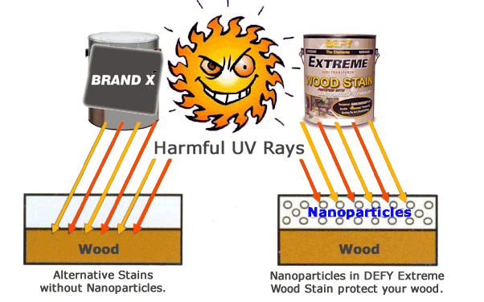
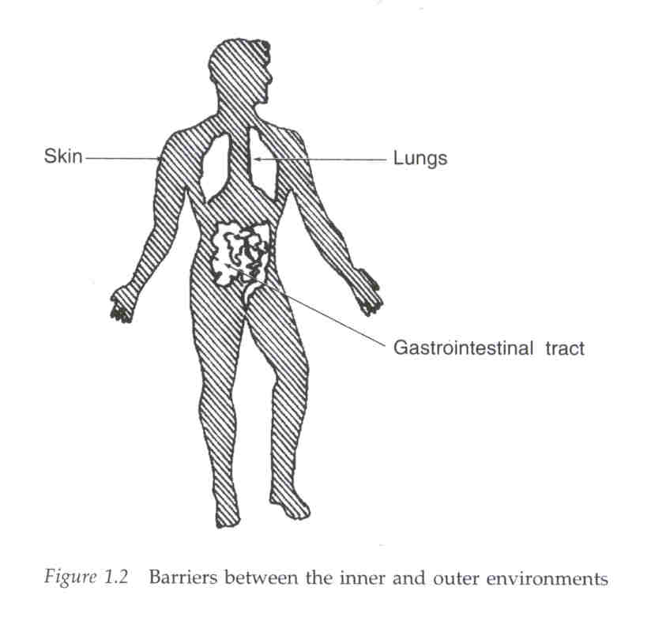
Case Study: Inorganic UV absorbers
Exposure Scenarios
Inhalation During Application
Spray Coatings
Ingestion During Application
Dermal Contact Post Application
  Followed by Ingestion?
Environmental Health, 3rd Edition. Dade W. Moeller
Notes:
Partilces like CeO2 and ZnO have been added to outdoor paints/stains to increase UV Protection. They are favored over classic organics cause it is assumed they wont break down as quickly.
To understand exposure to this product – have to think about intended use. Inhale – Dermal – and Ingestion
Lots of problems start to come up when you want to do these kinds of tests. Just thinking about lung exposure…what fluid – about 10 varitietrs of just something called Gambles solution

Slide 4
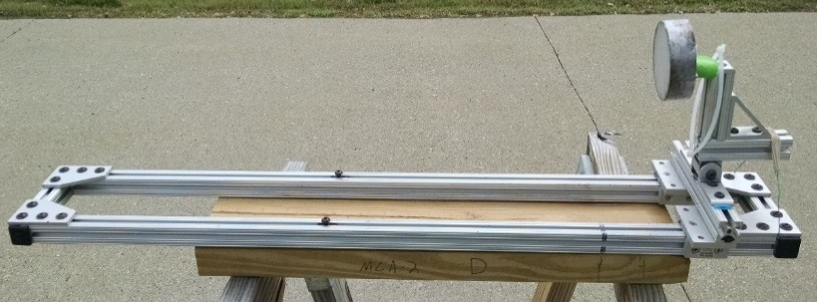
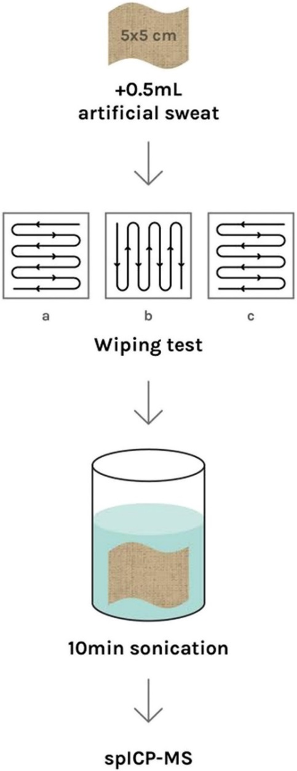
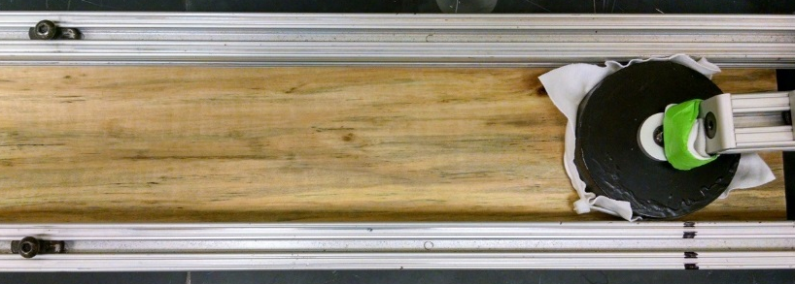
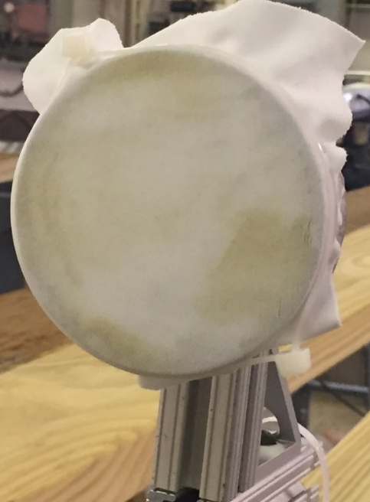
Inorganic UV absorbers: Dermal Contact
What Method to Use?
OECD, ISO, ASTM
NIOSH, CPSC
Test Duration?
Long term release or only near field?
Surface Character?
Aged vs. Pristine
Use Profile
Intended & Foreseeable Misuse?
Mackevica et al., NanoImpact., 2018
Notes:
More experience working with Dermal contacvt studies. Again there is the same issue. Lots of methods out there to look at dermal transfer of materials applied to surfaces. What do you use.
Midd Photos – CPSC wipping apparatus – initial used to track release of Cu, Cr, As from CCA lumber – adopted in my work.
Right photo – other methods use protocols from ISO. Hand wipe surface in series of patterns – reproducible?
Other considerations. How long do you do this. Can you accelerate the process. What about intended and missue of the coating?

Slide 5
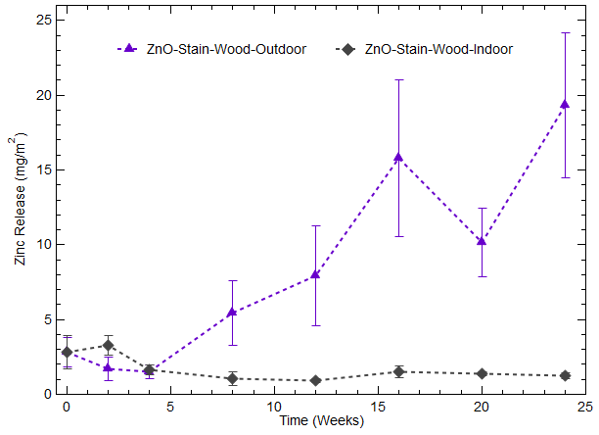
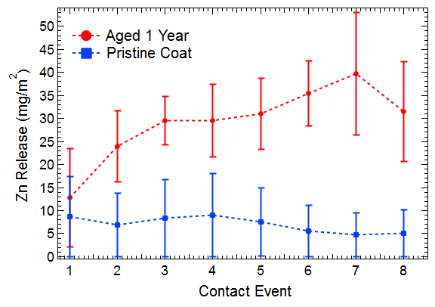
Inorganic UV absorbers: Dermal Contact
Total Zn Release between 3-25 mg /m²
Focus on realistic use scenarios
Attempt to track both short term and long term exposure
Totals provide no information on physical state of the dislodged material
Clar et al., Sci. Tot. Env., (In Prep)

Slide 6
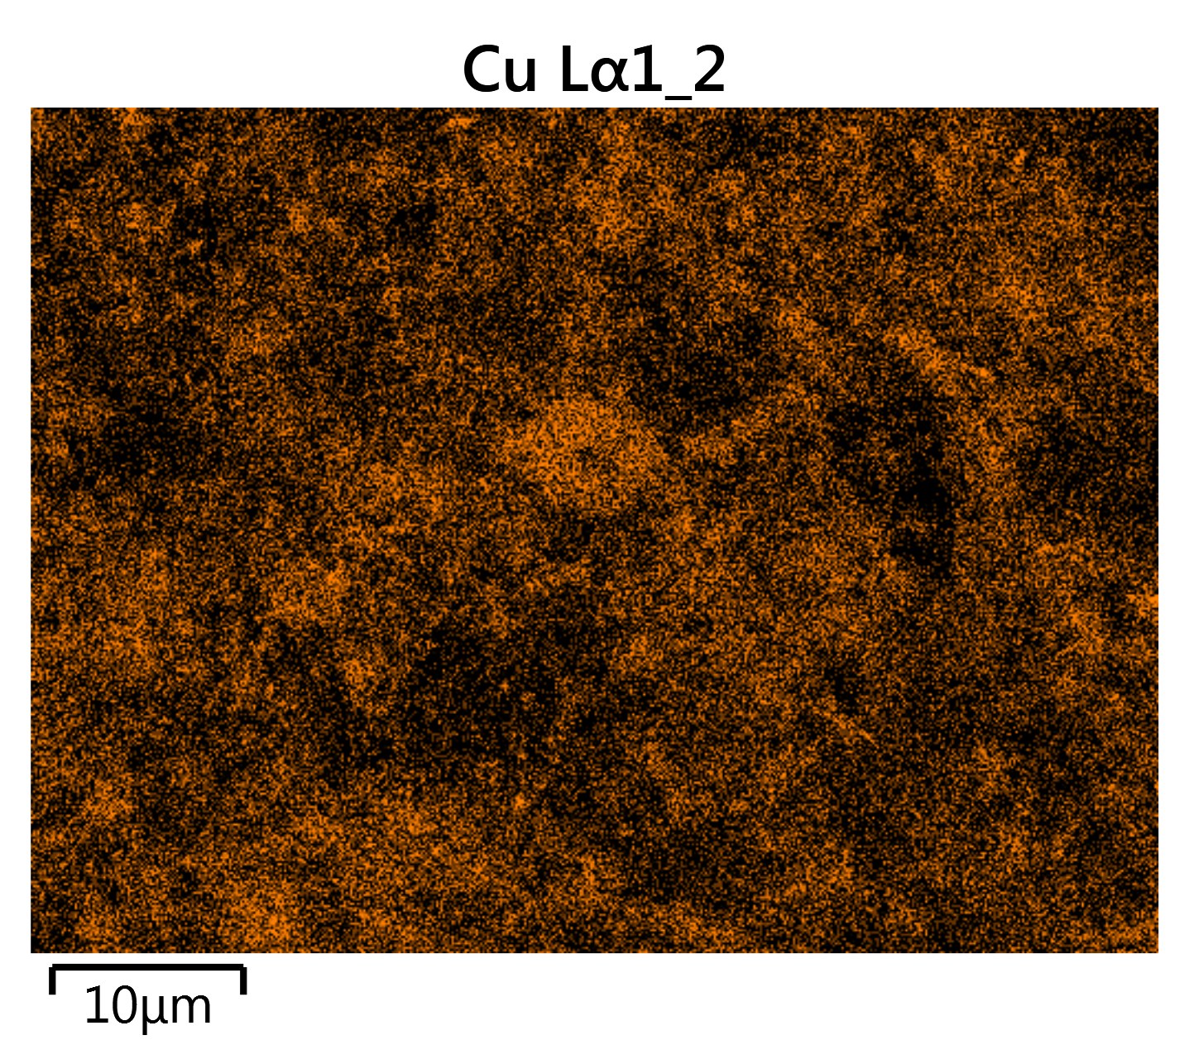
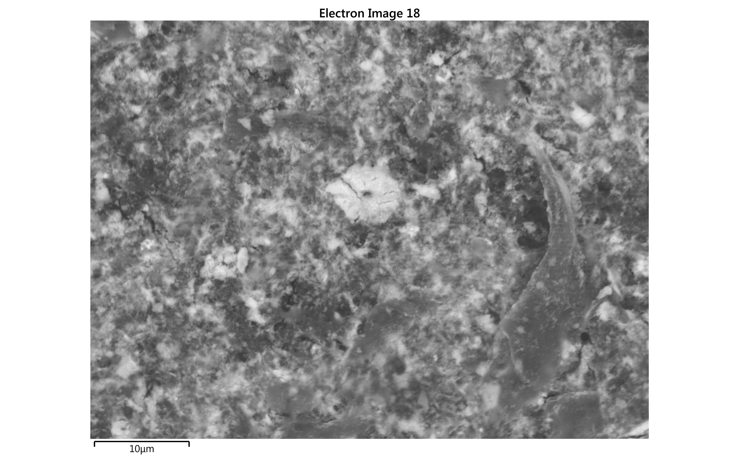
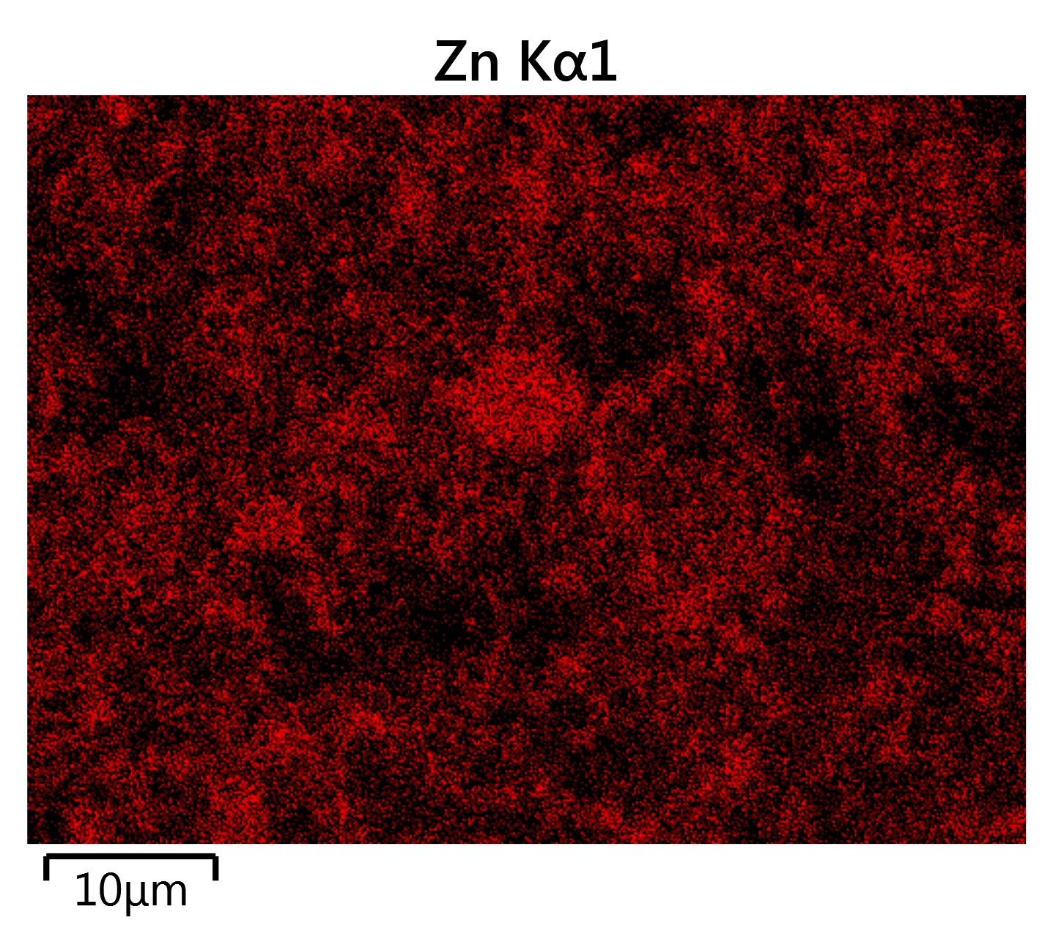
Dermal Contact & Ingestion
Heteroaggregates dislodged from the surface
Wood Stuffs
Heavy location of Zn with Cu in the lumber.
Does this quality as a true “Nano Exposure” Scenario

Slide 7
Big Picture
Urgent Need to develop/modify reliable, reproducible Standard Methods to study NP and NP byproduct release from consumer products
  Current techniques are designed to best suite needs/capability of laboratory
  Focus on method development that makes critical data easily accessible
Methods must focus on both intended use and reasonably foreseeable misuse of nano-enabled products
  Aged Surface vs. Pristine Surface
Detailed Characterization of released/transformed materials is a critical component of risk assessment and management

Slide 8



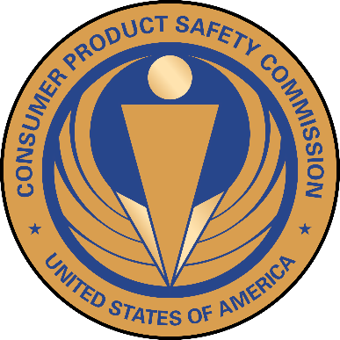
Acknowledgements
Dr. Todd P. Luxton
Dr. Kirk G. Scheckel
Dr. William Platten III
Nick Sylvest
Eric Baumann
Dr. Andrew Remsen
Treye Thomas - CPSC
Annie Yang
Sydney Thornton
Avery Hatch
Sarah Boggins

Slide 9
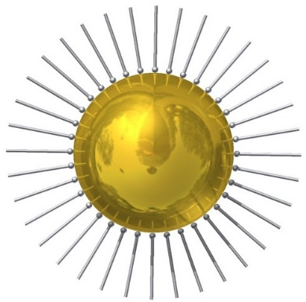

Ideal Risk Analysis Tool for NPs
Initial Desire for “Read Across” Tables to Predict Ultimate Fate & Risk
Nanoparticle
Coating
Environmental Fate
+
Intrinsic Properties:
Identity (Cd/Se QD vs. ZnO
Size
Shape
Surface Charge
Core/Shell
Human Health Risk
Polymers
Surfactants
Organic Matter
Process is much more complicated
Once imbedded in a product, NP characteristics properties Change
Release is also depending on use conditions
Extrinsic Properties:
Dissolution Rate
Sedimentation Rate
Attachment Efficiency
Notes:
Want Read Across Tables to predict these things. Over the last 5 or so years it has becoming abundantly clear that its not that simple.
Once dispersed in product matrix properties change. Release and exposure if deepening on use conditions as well as potential mode of entry in biological systems and environmental compartment in environmental systems

Slide 10
Life Cycle and Fate of Nanomaterials
Synthesis methods
Release
Environmental Health
End Points
Biota
Critical Components
Realistic Exposure Concentrations
Speciation of release material
  Particles
  Ions
  Aggregates (Homo and Hetero)
Property Change
- post-synthesis
- intermediate
production
Release
NANO-PRODUCTS
Release
Humans
End of Life
Release
Notes:
NP Consumer Product Life Cycle. A great deal of attention has been paid to characterization in initial stages. What is produced, and how can we manipulate properties for specific outcomes. i.e.., tunability of QDs, size and morphology of products etc.

Slide 11
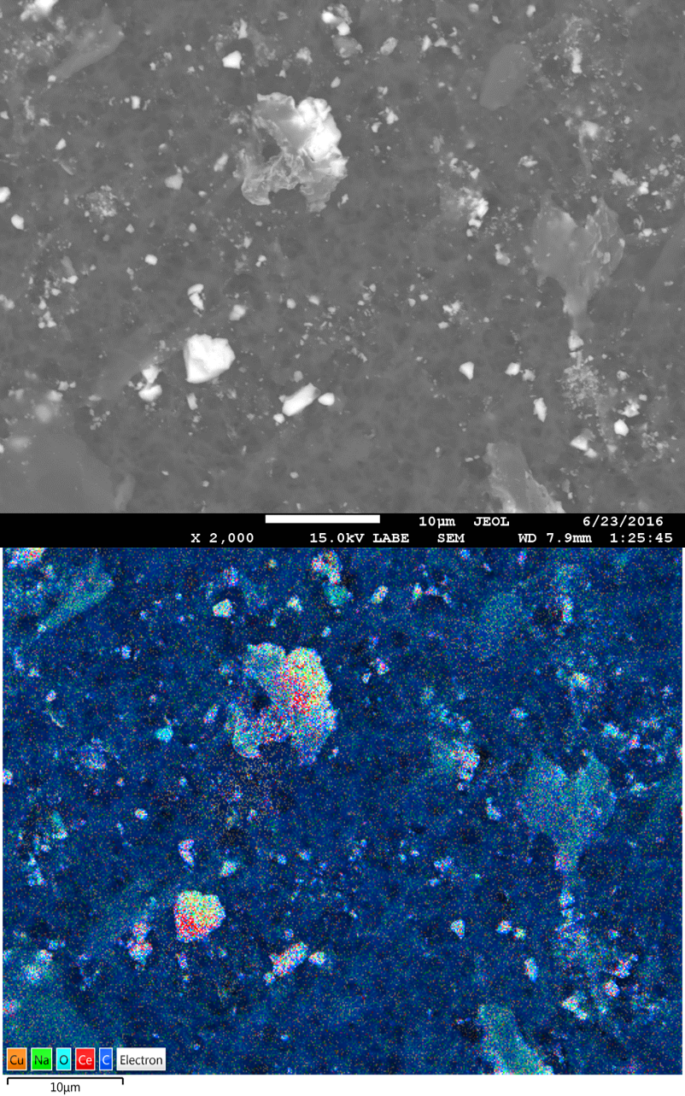
Dermal Contact & Ingestion
Heteroaggregates dislodged from the surface
Larger chunks of lumber with CeO2 attached
Very few “Free” NPs released
Does this quality as a true “Nano Exposure” Scenario

