Slide 1
Particle Number Emission Rate Calculations Used in Measuring Emissions from Fused Deposition Modeling 3D Printers
Peter Byrley¹, William K. Boyes², Kim Rogers³
¹ORAU Student Services Contractor to Exposure Methods & Measurements Division, National Exposure Research Laboratory, USEPA
²Toxicity Assessment Division, National Health and Environmental Effects Research Laboratory, USEPA
³Exposure Methods & Measurements Division, National Exposure Research Laboratory, USEPA
Notes:
Qian = Ch’ien = “Tchi’en”

Slide 2
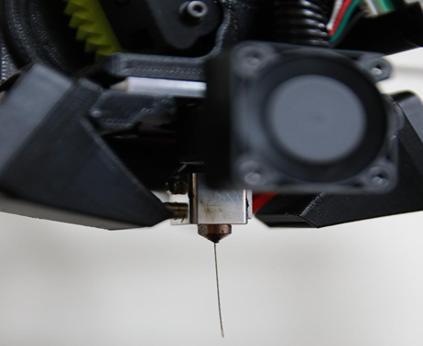
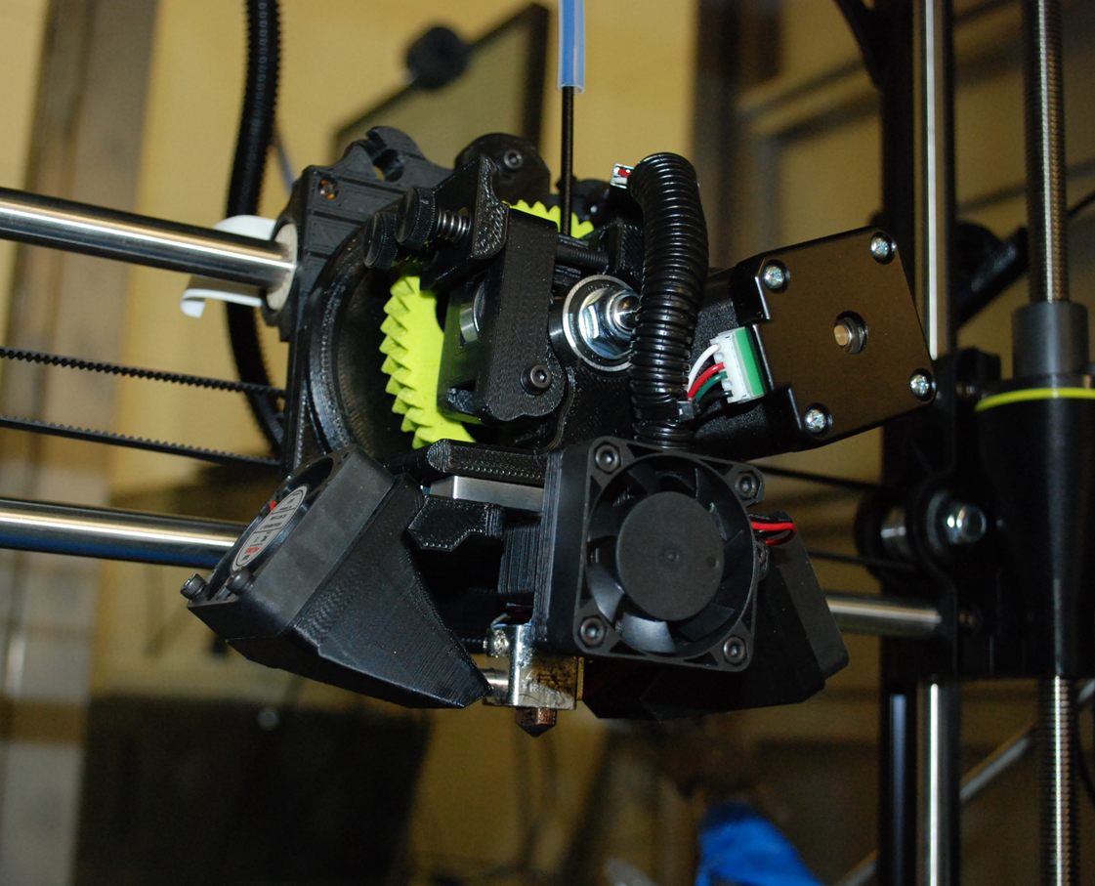
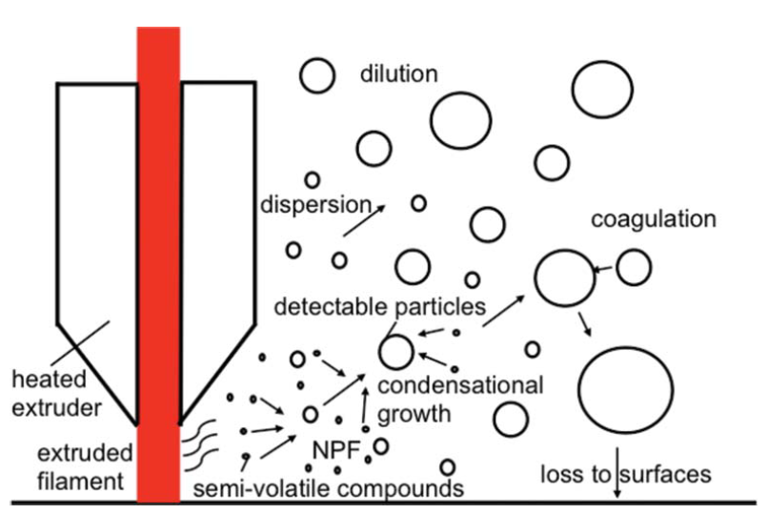
How Do FDM 3D Printers Emit Particles?
As filament is pushed through the nozzle, the nozzle is at around 200 deg C
Billions of particles per minute released
Majority of particles in the ultrafine range (<100 nm in diameter)
Volatile organic compounds including styrene may be released
Metals?
Zhang Q, Wong JPS, Davis AY, Black MS, Weber RJ. Characterization of particle emissions from consumer fused deposition modeling 3D printers. Aerosol Sci Technol [Internet]. 2017;51(11):1–12.

Slide 3
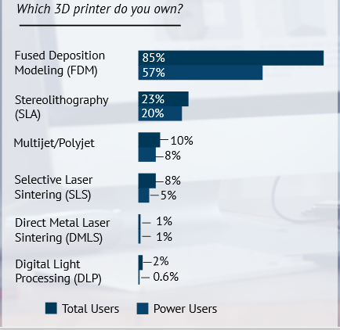
Why Should We Care About FDM 3D Printers?
FDM printers are extremely popular for at home or office use
278,000 desktop 3D printers (under $5,000) were purchased worldwide in 2016 (majority in U.S., Europe, South Korea)
As 3D printers penetrate the consumer marketplace more, public opinion will shape the fate of this industry
Cassaignau A, Core-Baillais M, de Wargny M, Lonjon C. Sculpteo. THE STATE OF 3D PRINTING The data you need to understand the 3D Printing world and build your 3D Printing strategy. 2016;(May).
Forbes.com, “Wohlers Report 2016: 3D Printing Industry Surpassed $5.1 Billion” 2016

Slide 4

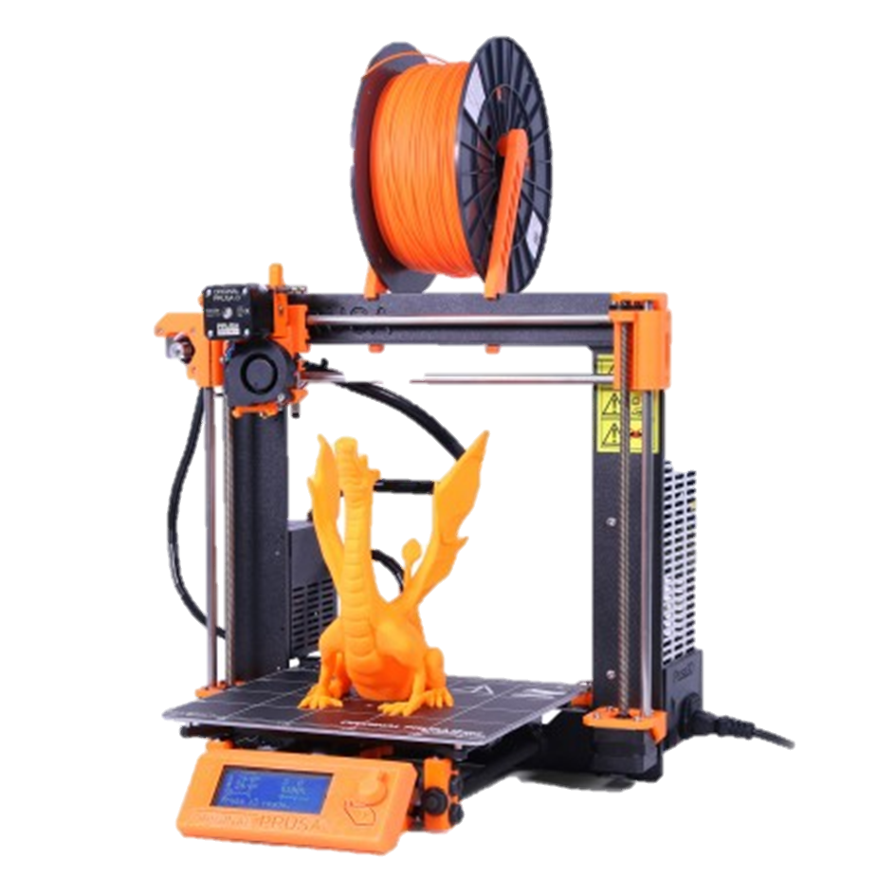

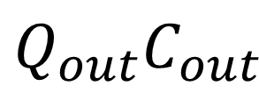
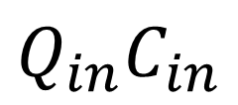

When Measuring Particles Emitted from a 3D Printer…
There’s a lot to Consider
Room/Chamber
$$L$$
$$Q_{in}C_{in}$$
$$Q_{out}C_{out}$$
$$E$$

Slide 5
Particle Number Emission Rate Methods
Yellow=Standard terms
Red=Unique loss or Q_{in} terms
References on last slide

Slide 6
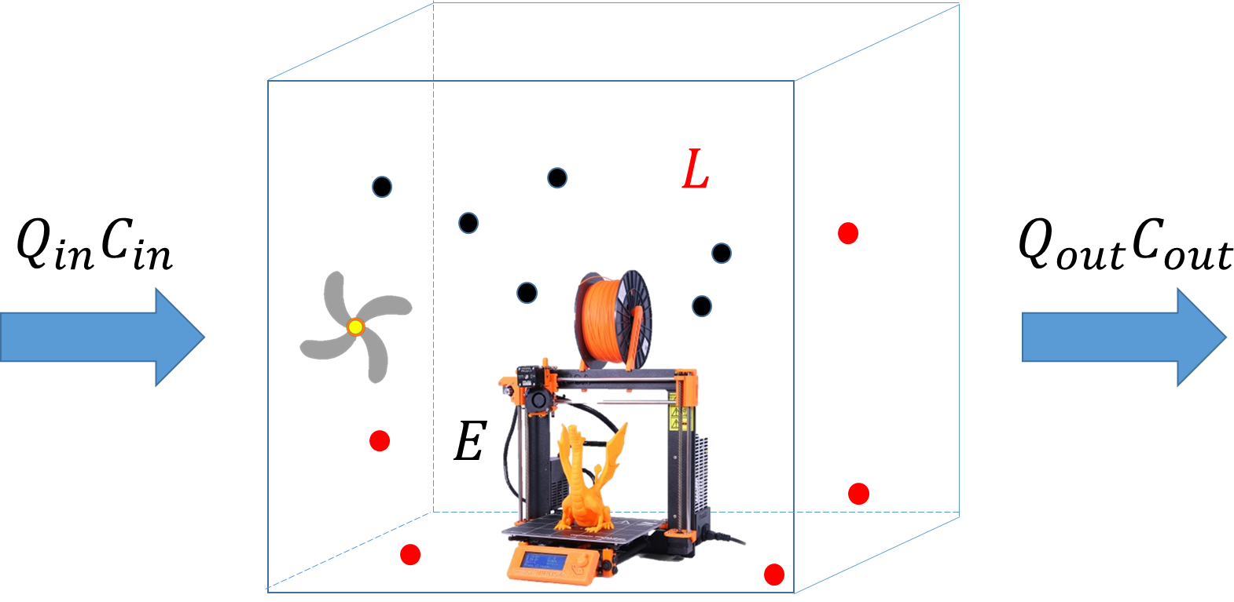
Negative Emission Values?
Printers are either off or emitting. They cannot “suck up” emissions in the chamber
This tells us that some loss is unaccounted for
Agglomeration, settling onto surfaces, leakage
“…the emission model…does not account for aerosol agglomeration…to adjust for this effect, negative emission values were eliminated before the total aerosol emissions were calculated…
Vance, M. E., Pegues, V., Van Montfrans, S., Leng, W., & Marr, L. C. (2017). Aerosol Emissions from Fuse-Deposition Modeling 3D Printers in a Chamber and in Real Indoor Environments. Environ Sci Technology, 51(17), 9516-9523.
Notes:
Paraphase quote

Slide 7
The Need for a Standard Testing Apparatus and Emission Rate Methodology
Influxes and losses unaccounted for in the measuring chamber can affect emission rate results drastically
There needs to be both a standard testing procedure used and a standard equation used based on that experimental setup to accommodate influxes and losses
Zhang et al., 2017 includes some recommendations on how to best to perform 3D printer measurements
New 3D printer filaments with ENMs including carbon nanotubes, graphene and metal particles will need to be tested
Zhang, Q., et al. (2017). "Characterization of particle emissions from consumer fused deposition modeling 3D printers." Aerosol Science and Technology 51(11): 1275-1286.

Slide 8
Slide 8 References
Yi, J., et al. (2016). "Emission of particulate matter from a desktop three-dimensional (3D) printer." J Toxicol Environ Health A 79(11): 453-465.
Azimi P, Zhao D, Pouzet C, Crain NE, Stephens B. Emissions of Ultrafine Particles and Volatile Organic Compounds from Commercially Available Desktop Three-Dimensional Printers with Multiple Filaments. Environ Sci Technol. 2016;50(3):1260–8.
Vance, M. E., Pegues, V., Van Montfrans, S., Leng, W., & Marr, L. C. (2017). Aerosol Emissions from Fuse-Deposition Modeling 3D Printers in a Chamber and in Real Indoor Environments. Environ Sci Technology, 51(17), 9516-9523.
Floyd, E. L., Wang, J., & Regens, J. L. (2017). Fume emissions from a low-cost 3-D printer with various filaments. J Occup Environ Hyg, 14(7), 523-533.
Barthel, M., Seeger, S., Rothhardt, M., Wilke, O., Horn, W., Juritsch, E., . . . Jann, O. (2013). Measurement of Fine and Ultrafine Particles from Office Devices during Printing in order to Develop a Test Method for the Blue Angel Ecolabel for Office-Based Printing Devices.

Slide 9
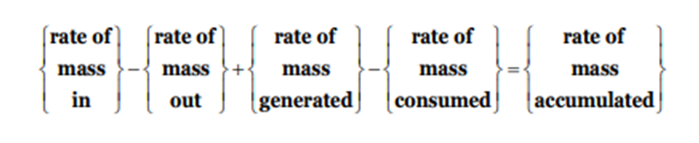
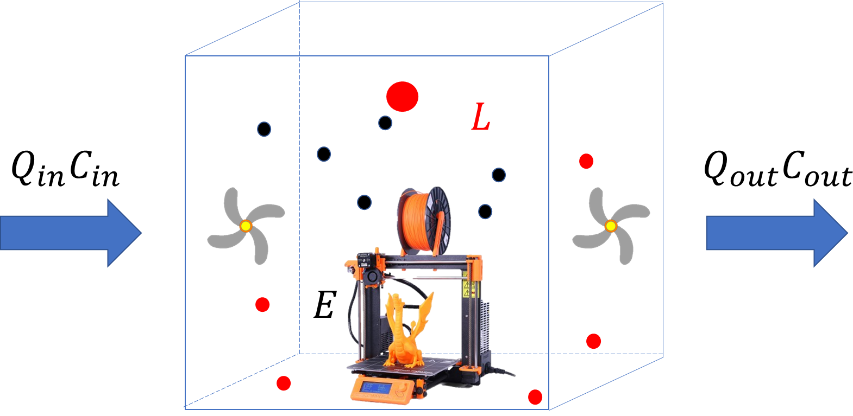
Basis of Dynamic Mass Balance Particle Number Emission Rates
Strenstrom, M.K. Fundamentals of Chemical Reactor Theory. UCLA, 2003

